Slide 1
Program Migration
Visualization for Actionable Intelligence in STEM Retention
Presented by:
Arthur Pasternak
Research Analyst, Analytic Studies & Institutional Research
San Diego State University

Slide 2
Common Questions
Out of the students that start in our department, how many graduate?
Out of those who graduate, did they graduate in our department?
If they didn’t graduate in our department, where did they end up?
Commonly asked by administrators, deans, department chairs.
Graduation rates didn’t tell the whole picture
Rates only tell whether student graduates from the University, not if they graduate from the given college/department.
Individual within-department graduation rates were poor.
Likely reflects student movement.

Slide 3
Program Initiatives Spur Further Study
Two program initiatives led to further study of this common question.
Academic Program Reviews.
Need to figure out why grad rates are low.
Focus on STEM recruitment, retention, and persistence.
Need to figure out which programs pose challenges for students.
How do we improve?

Slide 4
Tools to Conceptualize This Question
Excel?
Go to piece of software.
Too focused on tabular presentation.
Hard to share findings with large audience.
Not a good choice given others available and other initiatives already underway.
JavaScript and D3?
Lots of good innovative visualizations out there.
Requires programming, can get very technical.
Unclear how to maintain.
Tableau?
Data visualization software.
Already being used for transforming Program Review documents.
Already have Tableau Server at SDSU that can be leveraged to share visualization and findings with large campus audience.
Decided to go with Tableau.

Slide 5
Challenges Using Tableau
No built-in visualizations that could present “flow” between one department and another.
Needed to build custom visualization.
Discovered resources on the web on how to build “Sankey” diagrams using Tableau – These are diagrams that effectively show flow lines between start and endpoints.
Tableau Community – Olivier Catherin
Data + Science – Jeffrey Shaffer

Slide 6
But before we begin the technical stuff…

Slide 7
Challenges Using Tableau Cont’d
One problem though…
All online examples on how to build this use a relational data source.
We use an OLAP cube data source at ASIR!

Slide 8
Excel to the Rescue!
Figured out that instead of directly connecting to a cube data source, could use Excel’s PowerPivot feature to act as a middle-man.
Basically, extract OLAP cube data from our MS Analysis Services data server and create a PowerPivot data model in Excel that acts as a “flat-file”.
Connect Tableau to this Excel PowerPivot file, and use that data to build the visualization from there.
OLAP CUBE
MS Analysis Services
Excel
PowerPivot
Tableau

Slide 9
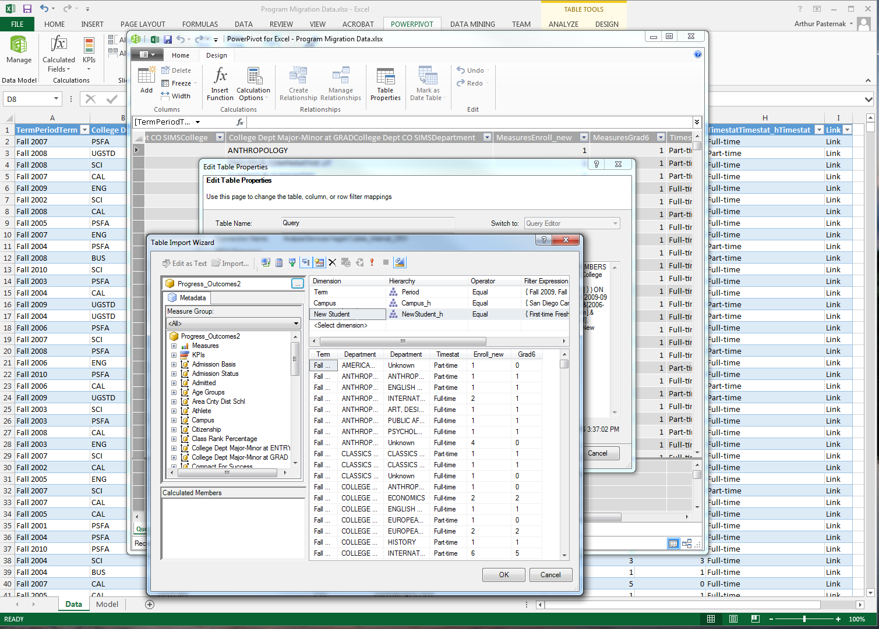
Excel PowerPivot

Slide 10
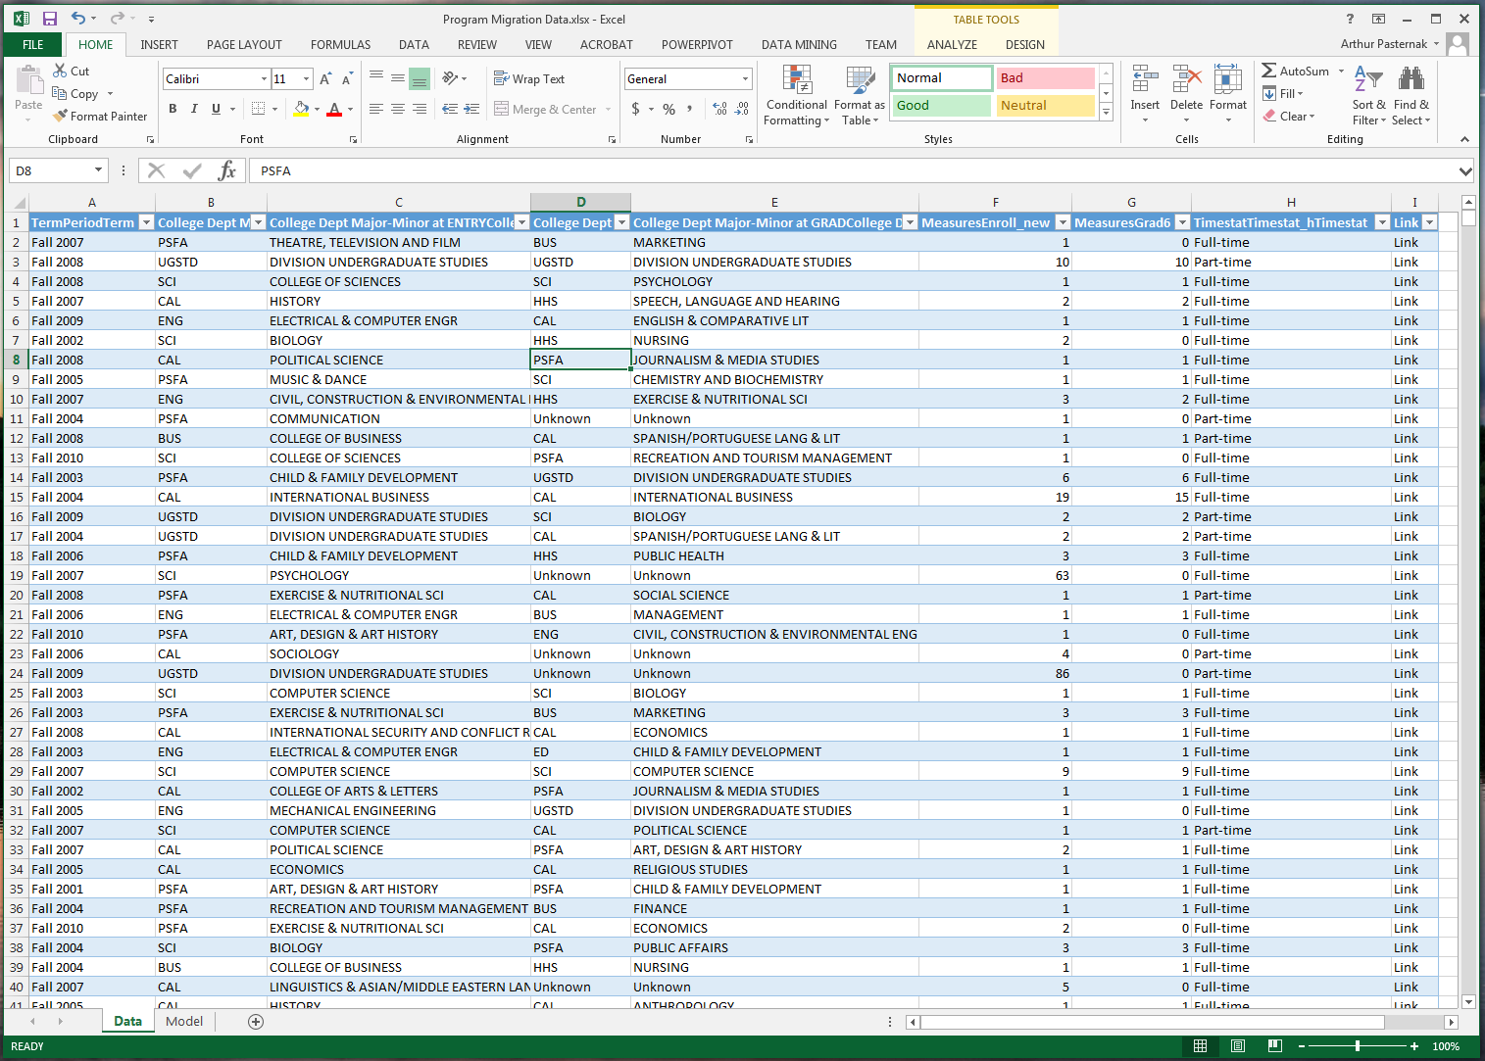
Excel PowerPivot Model

Slide 11
The Data
Within the Excel PowerPivot (basically an Excel workbook) create two sets of data:
One has the actual student entry and graduation data, along with a “link” column repeated for every row.
The other has the data used to help Tableau draw the flow lines in the visualization.
Combine these two data sets in Tableau by creating a join on “link” column.

Slide 12
Advantages of using this approach…
Fast connection, can use a data extract to load the data into Tableau.
Normally we use an OLAP Cube connection to create our dashboards, but the more complex the dashboard, the slower they are. This avoids that problem.
Data is aggregated from the outset, we’re not accessing individual student records in the data model, so no issues with data security per se.
Relatively easy to maintain the data once the Excel file structure is set.

Slide 13
Disadvantages…
If you want to add more data points (such as different grad rate measures), a bit more cumbersome to modify the data model so as to not break the visualization.
Data densification… the more rows of data you add, the data model in Tableau gets exponentially bigger.
Initial learning curve for end-users on how to use and interpret the dashboard.
Squeezing in many departments and/or majors makes it hard to fit all the data into one view.

Slide 14
Reaction
Implemented the visualization as part of the revamped academic program review and student advising dashboards developed by ASIR.
Positive feedback from users such as department advisors, department chairs, and college deans regarding the value of the information.
Gets at the question of “where did they go?”
Identify programs that have a lot of attrition.
Starting a conversation about how to improve program efficacy.
Starting a conversation about how to “catch” students who are struggling early, and perhaps advising them into other study options. Improve graduation time.

Slide 15
Questions?

Slide 16
Thank You!
Arthur Pasternak
Research Analyst, Analytic Studies & Institutional Research
San Diego State University
Email: apasternak@mail.sdsu.edu
Analytic Studies & Institutional Research Website: https://asir.sdsu.edu/

