Slide 1
Using SPSS Modeler and STATISTICA to Predict Student Success on High-Stakes Examinations
Dr. Galina Belokurova
Assistant Director,
Institutional Research
Dr. Chiarina Piazza
Associate Dean,
College of Nursing

Slide 2
Dr. Chiarina Piazza
Associate Dean, College of Nursing

Slide 3
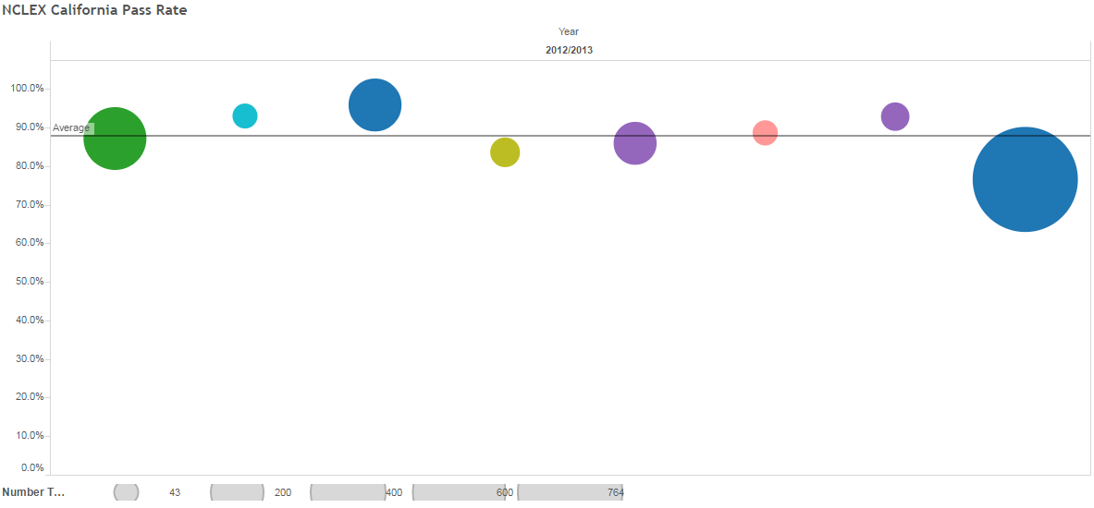
NCLEX Pass Rate – CA 2012/13
WCU
http://www.rn.ca.gov/education/passrates.shtml
Notes:
The NCSBN Board of Directors voted in December 2012 to raise the passing standard for the NCLEX-RN. The passing standard was revised from -0.16 logits to 0.00 logit. This passing standard was implemented April 1, 2013, in conjunction with the 2013 NCLEX-RN Test Plan.

Slide 4
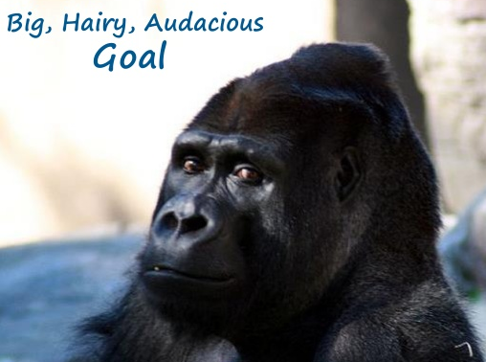
Our BHAG
Achieve 75% NCLEX-RN pass rate to meet BRN benchmark
Achieve 80% NCLEX-RN pass rate to meet CCNE benchmark

Slide 5
Dr. Galina Belokurova
Assistant Director, Institutional Research

Slide 6
Nuts & Bolts of Predicting NCLEX Outcomes
Predict vs Explain
Machine Learning
Accuracy (Bias) and Stability (Variance) of Predictive Algorithms
Do results differ across software packages (includes comparative demonstration of SPSS Modeler 16 and STATISTICA)?
** Parts of this project were developed in collaboration with Dr. Mahmoud Albawaneh and Dr. Mark Riddle
Notes:
Explanatory and especially causal models emphasize all variables that contribute to the outcome. Some of the effects, however, are very small. Predictive models focus on variables and their interactive effects that have decisive influence on outcomes.

Slide 7
Machine Learning
Unsupervised: the computer assigns observations to groups based on their similarity / difference (K-means)
Supervised: the computer uses variables provided by the researcher to group observations (C&RT, Regression, Discriminant, C5.0)
Today we specifically focus on the second one

Slide 8
Stability of ML Algorithms
Unlike many traditional statistical methods, ML techniques rely on computational solutions and random sampling
How can we be sure that the results bear some connection to reality if there is no assumed distribution for comparison?
Experiment!

Slide 9
Preview
0. Pre-Modeling Tasks (data issues/balancing/ partition)
Predictors
Modeling
Evaluation
Output / Deployment

Slide 10
0.1 Data
1. Data Profiling (column/structure/business rules studies)
2. Data Quality (empty source tables / columns, nulls, inconsistent / invalid values, coding)
3. Data Warehouse: Star Schema (fact table and dimensions)
4. Meaningful Data Input (each row is a graduate,
no duplicates)
Notes:
0. Cannot stress enough that Machine Learning approach as sensitive to badly structured / erroneous data (garbage in – garbage out). Really recommend cleaning and structuring your data BEFORE loading it into your machine learning package. SPSS Modeler and STATISTICA do provide similar data manipulation tools, but they only work well with star schema data warehouses.
What are the variables/columns/dimensions you are including? Make sure there are no nulls in your dimensions’ attributes.

Slide 11
0.2 Why do we need balancing?
Relatively few NCLEX failures in the data
We know more about why students pass than why they fail
Notes:
Balancing refers to increasing the share of a rare outcome in the sample. Needs to be a trade-off between your desire to learn more about the factors influencing the outcome that is more rare and the loss of information about the outcome that is more common.

Slide 12
0.3 Why do we need partition?
Training and Testing Subsamples
Training → use for grouping
Testing → helps check model’s accuracy and precision
Models are built on different training and testing subsamples on each run. This is the source of variance.
Notes:
We need to partition the sample to allow for model evaluation. If we use the entire sample for training, we have no idea how our model may classify the new data. That is why we out aside a subsample to use for evaluation. Trade-off between precision and variance.

Slide 13
1. Predictors
Demographic
Institutional (program track, campus, status)
Course performance details (min and max grade)
Aggregate measures of academic performance
Entrance exams (min and max)
Independent ATI Assessments (min and max)
Virtual Coach
Notes:
First group includes measures that are a given – never change or change slowly over time. There is little you can do about these variables.
Day-to-day academic performance in various courses. Normally, faculty is responsible for the evaluation with all the problems that are often related to that.
Independent proctored assessments – from entrance exams to independent assessments students take over the course of their academic progress to the VATI preparation course designed for graduates.

Slide 14
Predictor Importance
Notes:
Predictor importance evaluates how strongly each of the predictors affects the outcome. It can be an F statistic (how F changes if you drop a predictor) or a p-value when comparing different groups of observations formed during the classification process. Similar results. You can easily see that the number of failed ATI assessments is the best predictor followed by VATI.

Slide 15
Failed ATI Assessments
Notes:
Here is the distribution of graduates by the number of failed ATI assessments.

Slide 16
Classification and Regression Tree I

Slide 17
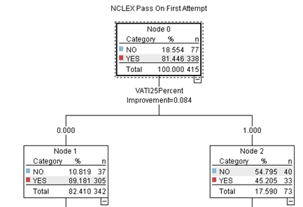
A Closer Look

Slide 18
C&R Tree II

Slide 19
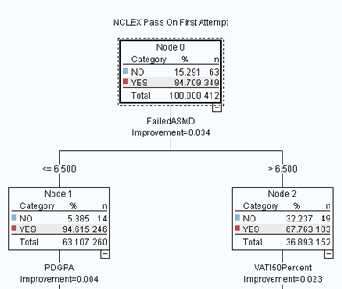
A Closer Look

Slide 20
Model Evaluation
What are a correct and a wrong predictions?
New Data | Predicted Fail | Predicted Pass
Actual Fail | 70 | 35
Actual Pass | 21 | 482
How do we evaluate C&R Trees and other classification models?
Partition | Training | % in Training | Testing | % in Testing
Correct | 511 | 88 | 552 | 91
Wrong | 67 | 12 | 56 | 9
Total | 578 | 100 | 608 | 100

Slide 21
Improving Model Accuracy/Stability

Slide 22
Accuracy (Bias): Boosting
Combine different models in one to improve accuracy. Can be prone to overfitting

Slide 23
Boosting Models’ Details

Slide 24
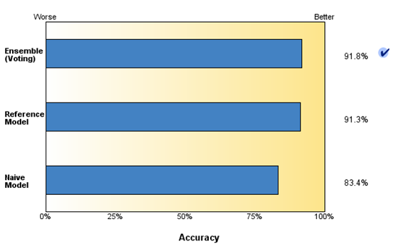
Reduce Variance: Bagging
Bagging is basically bootstrap averaging

Slide 25
Bagging Models’ Details

Slide 26
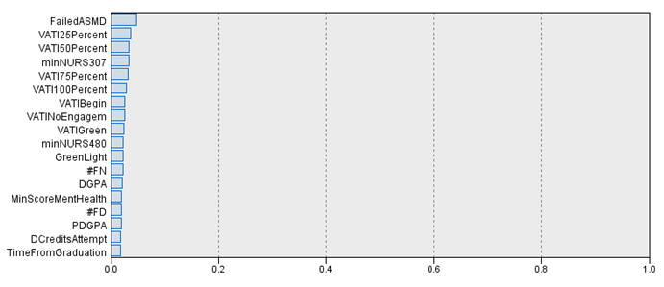
Predictor Importance in Ensemble

Slide 27
Other Ensembles
SPSS Modeler offers an automatic routine for creating an ensemble

Slide 28
Output
The output includes predicted outcome (Pass/Fail) and the probability of it occurring
2. Practitioners can decide how to assign costs of certain outcomes occurring
3. False Positives are costlier than False Negatives
4. False Positives can be treated as Negatives if the confidence is low

Slide 29
Interpreting Output

Slide 30
Deployment Tips
New Data | Predicted Fail | Predicted Pass
Actual Fail | 70 | 35**
Actual Pass | 21 | 482
**False Positives are in Red

Slide 31
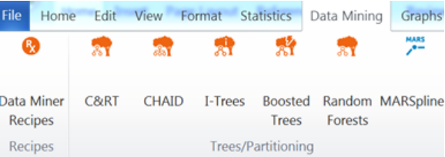
Using STATISTICA
Similar Models, Data Miner Recipes (automated)
Boosted Trees and Random Forests (Bagging) pose as separate entities

Slide 32
Balancing: More Control
Possible to create a stratified random sample
Easy to verify the composition of training and testing samples

Slide 33
Review
Results are surprisingly stable if predictors are strong
Models may vary in how they split observations into groups, but the big picture stays stable
Software packages also matter as proprietary algorithms may produce slightly different results, but the big picture is stable as well

Slide 34
Achieving BHAG
Steps Taken:
Continued Partnership with ATI
Core teams assembled who are dedicated to remediating students at risk (STARs)
Mechanisms developed to identify STARs early in core nursing program
Necessary resources provided for NCLEX success
Results:
2015-2016 WCU pass rate projected to be 87%
2016 Q3 CA pass rate was 95%

Slide 35
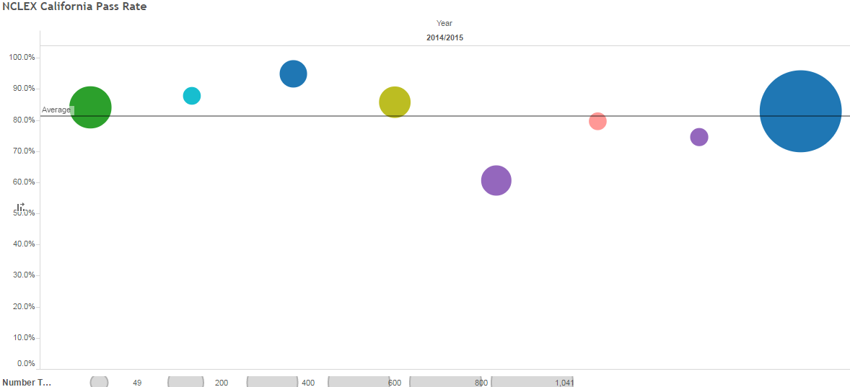
NCLEX Pass Rate – CA 2014/15
http://www.rn.ca.gov/education/passrates.shtml
Notes:
The NCSBN Board of Directors voted in December 2012 to raise the passing standard for the NCLEX-RN. The passing standard was revised from -0.16 logits to 0.00 logit. This passing standard was implemented April 1, 2013, in conjunction with the 2013 NCLEX-RN Test Plan.

Slide 36
Sustaining BHAG
Steps Ahead:
Create NCLEX Success Pathways according to the metrics determined to best reflect a student’s need for remediation

