Slide 1

An Integrated, Mixed Method Approach to Calculating Institutional Enrollment Capacity
Laura Kiralla, Ed.D. & Rosa Belerique, M.S.
Otis College of Art and Design
Notes:
LAURA

Slide 2
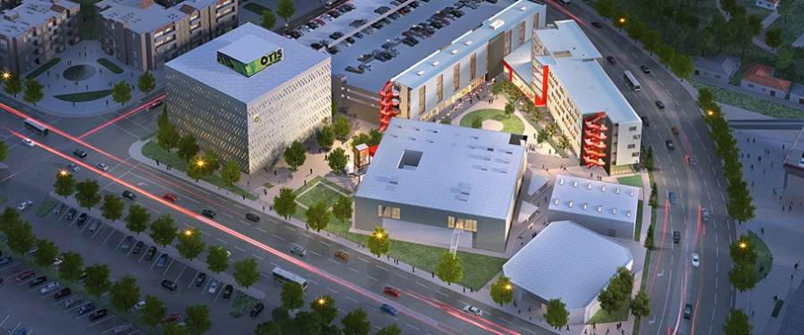
Otis College of Art and Design
Small, private art and design college in LA
7 undergraduate and 4 graduate majors
1,160 headcount in Fall 2015
41% Pell recipients in 2015-16; AANAPISI designated
Notes:
LAURA

Slide 3
Setting the Stage
Defining institutional enrollment capacity
Informing:
  Enrollment forecast
  Budget and resource allocation
  Space availability
  Recruitment efforts
Notes:
LAURA

Slide 4





Integrated Task Force
Randall Lavender, Provost
Laura Kiralla, Vice President for Student Success and Dean of Student Affairs
Kim Russo, Associate Provost for Academic Administration
Matthew Gallagher, Dean of Admissions and Financial Aid
Rosa Belerique, Director of Institutional Research and Effectiveness
Notes:
LAURA

Slide 5
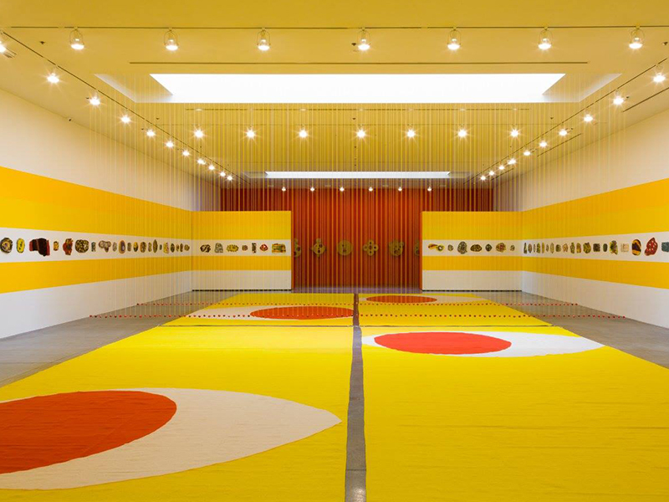
Methodology
Notes:
Rosa

Slide 6
Methodology
Mixed methods approach in Fall 2015
Quantitative
  Contact hours and room utilization
  Enrollment potential for class sections
  Historic maximum enrollment by academic major
Qualitative
  Focus groups with Department Chairs
Notes:
Rosa

Slide 7

Quantitative Measures
Notes:
Rosa

Slide 8
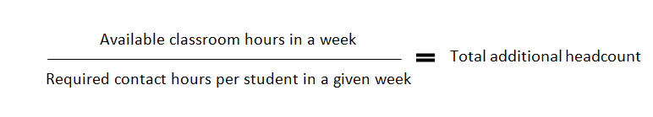
Contact Hours and Room Utilization
How many more students could we enroll if classrooms were utilized at maximum efficiency?
Analyzed all classroom time available in a typical week in Fall 2015 from 8am-10pm
Equation:
Notes:
Rosa
Data from a typical week in Fall 2015 revealed that there were 2,189 hours of unused classroom time across the College between 8am-12:30pm. With a student, regardless of class level, required to take on average 24 hours a week of class time, a simple calculation (2,189 available classroom hours a week / 24 contact hours required a week per student = 91 students) indicates 91 additional students could be enrolled at Otis if classrooms were used to their fullest potential. Taken at face value, an additional 91 students added to Fall 2015’s census number of 1,161 would suggest a College-wide enrollment capacity of approximately 1,252.

Slide 9
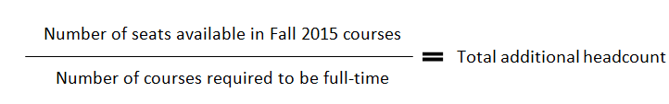
Enrollment Potential for Class Sections
How many classes are under-enrolled?
Which classes are over-enrolled?
Where could consolidation or cancellation occur for maximum efficiency?
Equation:
Notes:
Rosa
-Removed internship and independent study courses
-Our student information system (Banner) provides data on the maximum enrollment capacity for each course and what the total number of students enrolled is. I simply took the difference between all courses in a given week to obtain the number of seats available in Fall 2015 courses.

Slide 10
Historic Maximum Enrollment
If each program’s historic enrollment maximum occurred simultaneously where would we be?
What has each program been able to sustain over the last 12 years?
Notes:
Rosa

Slide 11

Qualitative Measure
Notes:
Laura

Slide 12
Focus Groups
What did all the chairs have to say about what their programs can support?
Considerations
  Block scheduling
  Space availability
  Pedagogy
  Facilitation
Notes:
Laura

Slide 13
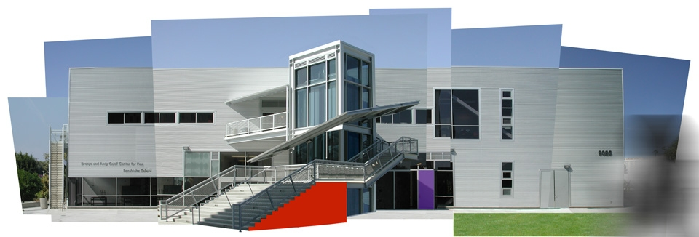
Results
Notes:
Rosa

Slide 14
Contact Hours and Room Utilization
2,189 available classroom hours
24 contact hours required per student
91 additional students added to 1,160 in Fall 2015 for a total of 1,252 students.
Notes:
Rosa
Data from a typical week in Fall 2015 revealed that there were 2,189 hours of unused classroom time across the College. With a student, regardless of class level, required to take on average 24 hours a week of class time, a simple calculation (2,189 available classroom hours a week / 24 contact hours required a week per student = 91 students) indicates 91 additional students could be enrolled at Otis if classrooms were used to their fullest potential. Taken at face value, an additional 91 students added to Fall 2015’s census number of 1,161 would suggest a College-wide enrollment capacity of approximately 1,252.

Slide 15
Enrollment Potential for Class Sections
1,235 seats available in Fall 2015
5.5 courses required on average per student
225 additional students added to 1,160 in Fall 2015 for a total of 1,386 students.
Notes:
Rosa
-Removed internship and independent study courses
With 1,235 seats available in scheduled courses in Fall 2015 and undergraduate students being required to take 5-6 courses per semester and graduate students being required to take 4-5 courses per semester, the College-wide average of courses taken in a given semester is 5.5. Therefore, if each course section offered was full in Fall 2015 an additional 225 students could be accommodated (1,235 seats available in Fall / 5.5 seats or courses required for each student = 225 additional students). Adding this number to our Fall 2015 census total of 1,161 would suggest a maximum enrollment of 1,386.
ourses

Slide 16
Historic Maximum Enrollment
Notes:
Rosa
Specifically, each program’s historical maximum enrollment was assumed to occur simultaneously, producing a hypothetical whole College enrollment total.
Through the last 12 years, the College’s overall enrollment has not surpassed 1,226

Slide 17
Quantitative Overview
The quantitative measure sets the ranges for where we believe with a degree of confidence the true number of our maximum enrollment capacity lies.
Notes:
Rosa: How would we now pinpoint the number.

Slide 18
Focus Groups
Notes:
Laura

Slide 19
Surprises
Chair of Liberal Arts and Sciences said they could only accommodate approx. 1,200 undergraduate students taking a couple LAS courses each, not 1,276.
Notes:
Laura LAS Topic

Slide 20

Conclusion
Notes:
Laura

Slide 21
Recommendations
In order for LAS to meet the UG maximum:
Convert at least 8 teaching studios to Smart Classrooms
Increase the number of online courses
Include a 3 week January term for LAS courses
Offer weekend and evening courses
Notes:
Laura

Slide 22
Maximum Enrollment Capacity
1,351 with LAS recommendations
1,276 with LAS limitations
Notes:
Laura
ROSA 17% growth over baseline, expected to take at least 10 years of growth a few percentage growth assuming consistency

Slide 23
Questions and Discussion
Notes:
Laura and Rosa

Slide 24
Agenda
Intro- Who (Laura)
  Who we are presenters (Laura/Rosa)
  Who we are Otis (Otis demographics) (Laura) Ariel view
Setting the stage (Laura)
  Why did we do this
Process (Rosa)
  Collaboration
  Methodology
Results (Laura/Rosa)
  Results to practice
  Surprise factors
Questions (10-15 mins)

