Slide 1
FREQUENT PATTERNS IN CALIFORNIA COMMUNITY COLLEGE STUDENT COURSE SEQUENCES
Bruce Ingraham, EdD
CAIR 2016, Los Angeles

Slide 2
Frequent Patterns in CCC Student Course Sequences
Outline
Introduction
Student Typologies
Lingering at community college
Assumptions
Methods
Results
Discussion
Summary

Slide 3
Frequent Patterns in CCC Student Course Sequences
Introduction
Multiple missions (California Community Colleges System Strategic Plan, 2006)
Associate degrees and certificates
Transfer education
Basic skills and English language proficiency
Economic and workforce development
Lifelong learning

Slide 4
Frequent Patterns in CCC Student Course Sequences
Student diversity
Educational goals
Demographics
College preparedness
How they use the colleges

Slide 5
Frequent Patterns in CCC Student Course Sequences
Student Typologies
(Boughan, 2000). The role of academic process in student achievement: An application of structural equation modeling and cluster analysis to community college longitudinal data.
(Adelman, 2005). Moving into town—and moving on: The community college in the lives of traditional–age students.
(Hagedorn & Prather, 2005). The community college solar system: If university students are from Venus community college students must be from Mars.
(Ammon, Bowman, & Mourad, 2008). Who are our students? Cluster analysis as a tool for understanding community college student populations.
(Horn & Weko, 2009). On track to complete? A taxonomy of beginning community college students and their outcomes 3 years after enrolling: 2003–04 through 2006.
(Bahr, 2010). The bird's eye view of community colleges: A behavioral typology of first time students based on cluster analytic classification.
(Bahr, 2011). A typology of students' use of the community college.

Slide 6
Frequent Patterns in CCC Student Course Sequences
Lingering at community college
Adelman — community college residence trichotomy, town metaphor
Homeowners (37%)
at least 30 units
at least 60% of total undergraduate units
Tenants (18%)
at least 30 units
fewer than 60% of undergraduate units
Visitors (45%)
1 to 30 units
Hagedorn and Prather – solar system metaphor
“While about half of the students have been enrolled for more than 4 years, approximately 15% have been enrolled for over 10 years within an educational environment that is frequently called a two-year college” (p. 11).

Slide 7
Frequent Patterns in CCC Student Course Sequences
Bahr (2011) Table 3.1 (p. 39)
Notes:
Core math and core English include both pre-transfer and transfer units.

Slide 8
Frequent Patterns in CCC Student Course Sequences
Assumptions
Departments offer courses in sequences
e.g. calculus 1, calculus 2, calculus 3, linear algebra, differential equations
Transfer-oriented students enroll in sequences of courses relevant to their intended baccalaureate majors
Students with similar interests form informal cohorts who enroll in the same or similar sequences of courses
Therefore, it should be possible to discover groups of students with similar sequences of courses over time

Slide 9
Frequent Patterns in CCC Student Course Sequences
Method

Slide 10
Frequent Patterns in CCC Student Course Sequences
Data
Source
Patrick Perry, former Vice Chancellor of Technology, Research, and Information Systems, CCCCO
Peter Bahr, University of Michigan, School of Education, Center for the Study of Higher and Postsecondary Education
Each campus had unique course IDs
Each campus had to be analyzed separately
Could not capture swirling
Students who attempted more than 60 units
Three largest campuses
East Los Angeles
Mt. San Antonio
Santa Ana

Slide 11
Frequent Patterns in CCC Student Course Sequences
Analysis method
Sequential Pattern Mining (SPM)
Data mining
“The exploration and analysis, by automatic or semiautomatic means, of large quantities of data in order to discover meaningful patterns and rules” (Berry & Linhoff, 1997, p. 5)
“The analysis of (often large) observational data sets to find unsuspected relationships and to summarize the data in novel ways that are both understandable and useful to the data owner” (Hand, Mannila, & Smyth, 2001, p. 1)
Data mining is NOT statistics

Slide 12
Frequent Patterns in CCC Student Course Sequences
SPM introduced by Agrawal & Srikant (1995)
Discovers frequent patterns in a sequence database
Courses in a frequent pattern do not have to be in consecutive terms
Frequent patterns can have two or more courses in a term
Support and minimum support
Anti-monotonicity (Ng, Lakshmanan, Han, & Pang, 1998)
all subsequences of frequent patterns are frequent
longer frequent patterns cannot have greater support than shorter subsequences
Maximal frequent patterns (MFP)
R arulesSequences package (Buchta & Hahsler, 2012; Hahsler, Buchta, Grün, & Hornik, 2010; Hahsler, Chelluboina, Hornnik, & Buchta, 2011; Hahsler, Grün, & Hornik, 2005)

Slide 13
Frequent Patterns in CCC Student Course Sequences
Results

Slide 14
Frequent Patterns in CCC Student Course Sequences
Exploratory data analysis
Sequence lengths: attempted units frequency distribution
Number of items: course frequency distribution

Slide 15
Frequent Patterns in CCC Student Course Sequences

Slide 16
Frequent Patterns in CCC Student Course Sequences
Notes:
Because of the anti-monotonicity property, only courses with support > 10% will appear in frequent patterns.

Slide 17
Frequent Patterns in CCC Student Course Sequences
Sequential Pattern Mining
Maximal frequent patterns
East Los Angeles: 602
Mt. San Antonio: 323
Santa Ana: 415
Longest MFPs

Slide 18
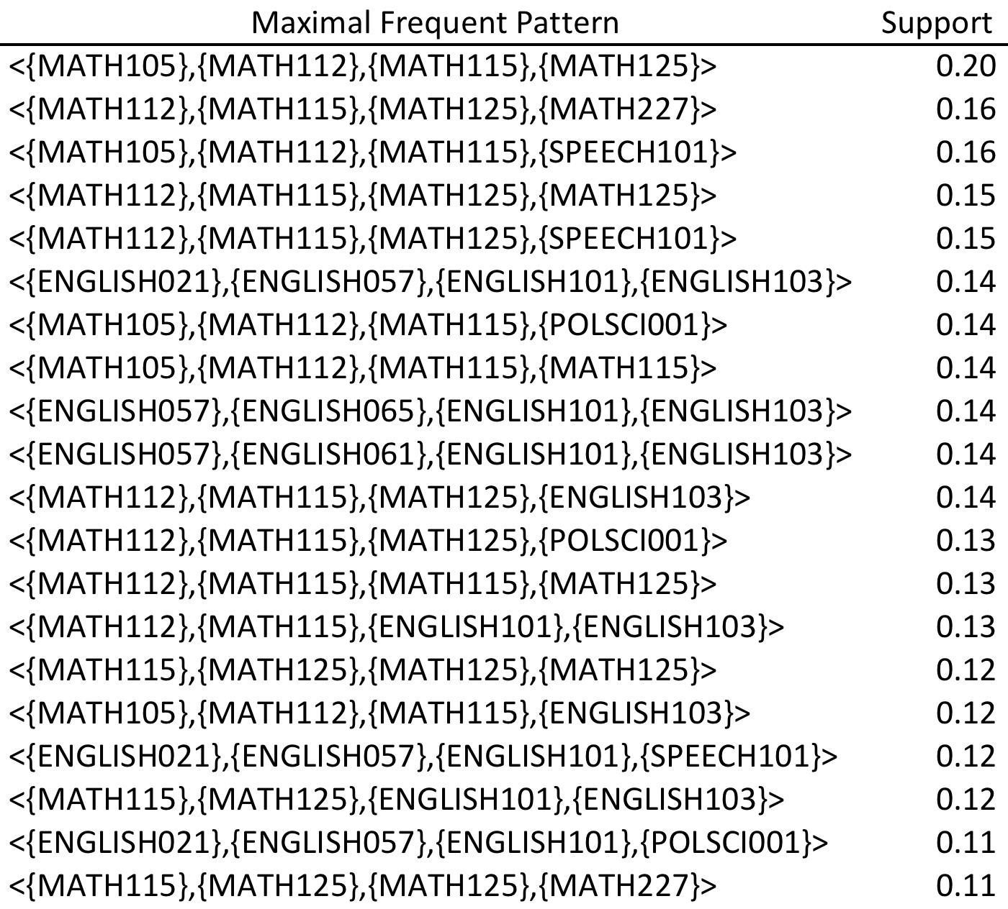
Frequent Patterns in CCC Student Course Sequences
East Los Angeles
Notes:
MATH105 (arithmetic), MATH112 (pre-algebra), MATH115 (elementary algebra), MATH125 (intermediate algebra), MATH227 (elementary statistics).
ENGLISH021 (English fundamentals), ENGLISH057 (basic reading and writing), ENGLISH061 (intermediate reading and composition: personal experience), and ENGLISH065 (intermediate reading and composition: fiction).
ENGLISH101 (college reading and composition I) and ENGLISH103 (composition and critical thinking).
SPEECH101 (oral communication I) and POLSCI001 (the government of the United States).

Slide 19
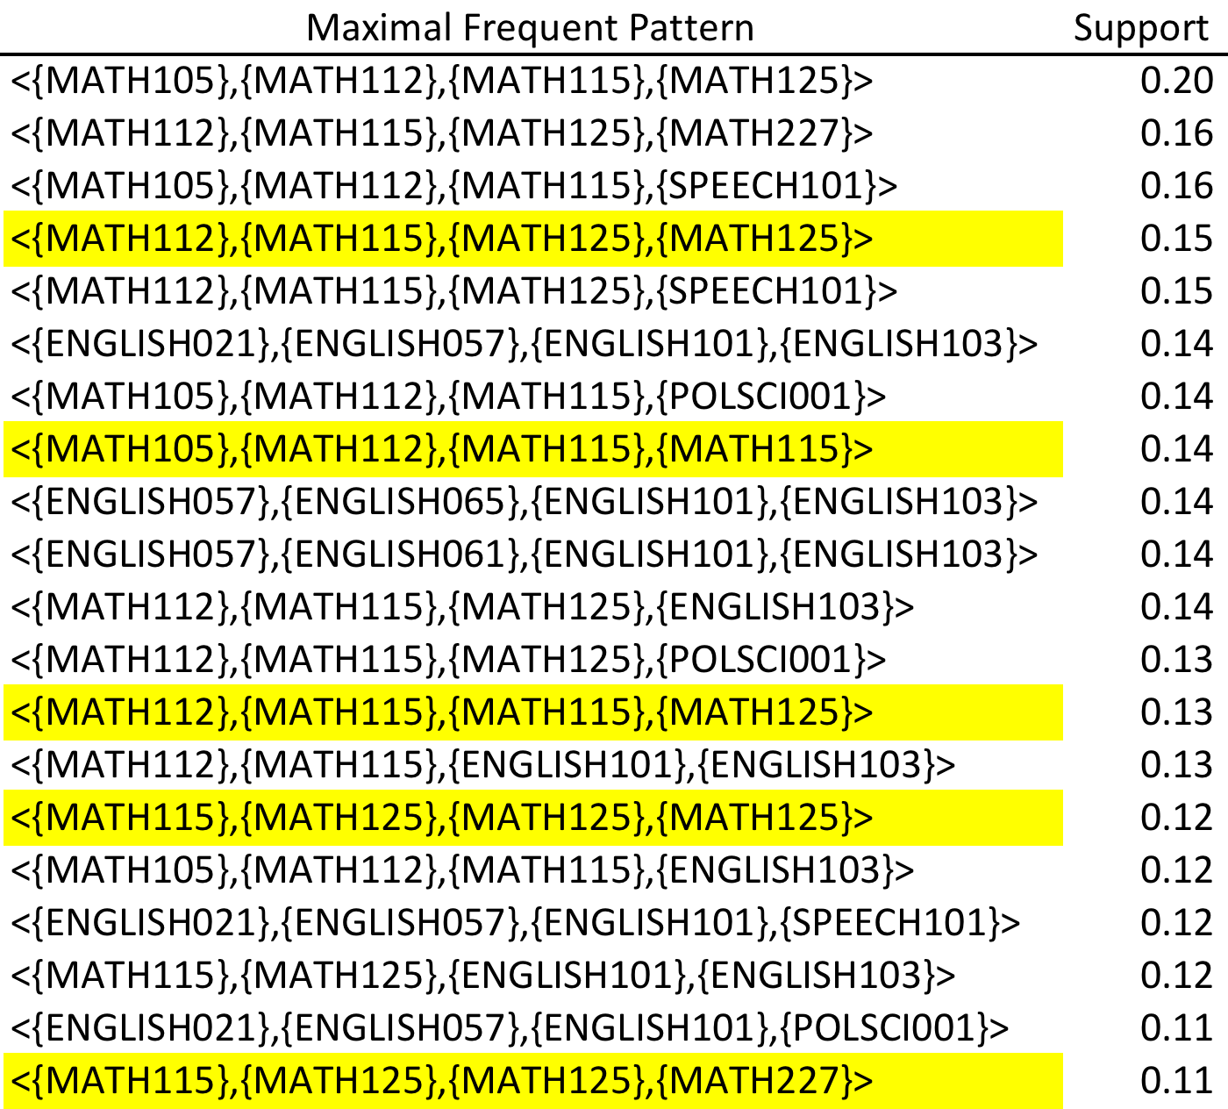
Frequent Patterns in CCC Student Course Sequences
East Los Angeles
Notes:
Repeat MATH115, MATH125

Slide 20
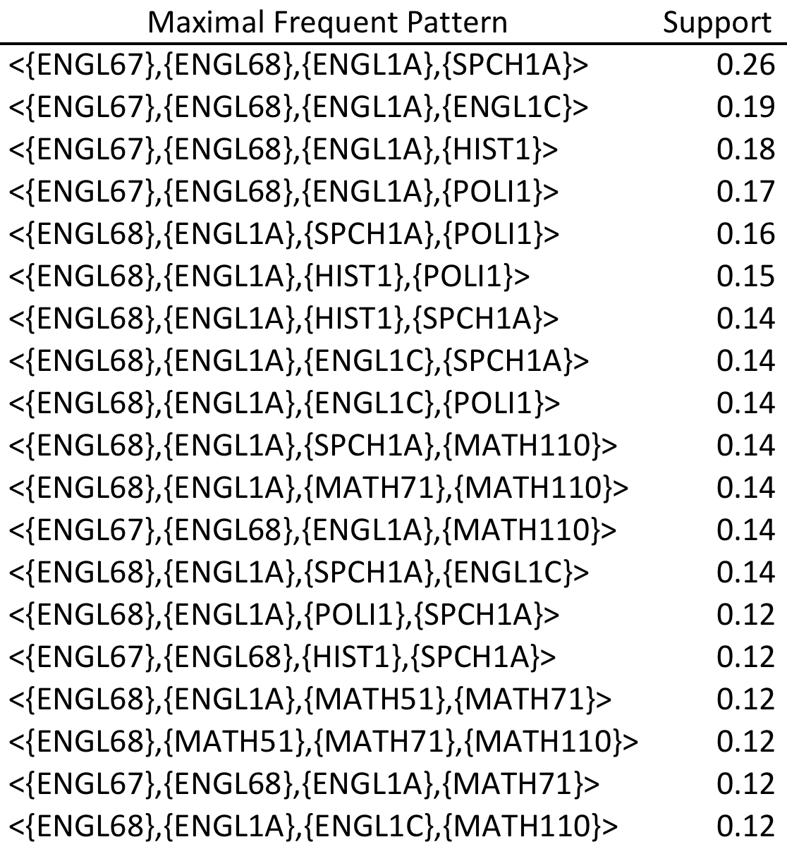
Frequent Patterns in CCC Student Course Sequences
Mt. San Antonio
Notes:
Predominance of English: ENGL67 (English – writing) and ENGL68 (English – writing), and college-level ENGL1A (freshman composition) and ENGL1C (critical thinking/writing).
MATH51 (elementary algebra), MATH71 (intermediate algebra), and MATH110 (elementary statistics).
SPCH1A (public speaking), HIST1 (history of U.S.), and POLI1 (political science).

Slide 21
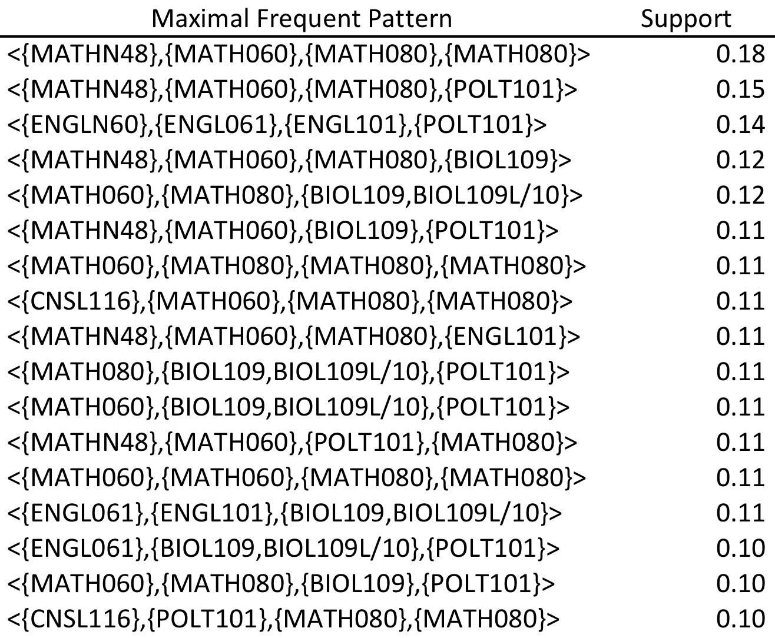
Frequent Patterns in CCC Student Course Sequences
Santa Ana
Notes:
MATHN48 (pre-algebra/algebra basics), MATH60 (elementary algebra), and MATH80 (intermediate algebra).
ENGLN60 (basics of effective writing), ENGL061 (introduction to composition), and ENGL101 (freshman composition).
BIOL109 (fundamentals of biology) and BIOL9L/10 (fundamentals of biology laboratory), POLT101 (introduction to American government) and CNSL116 (career/life planning and personal exploration).

Slide 22
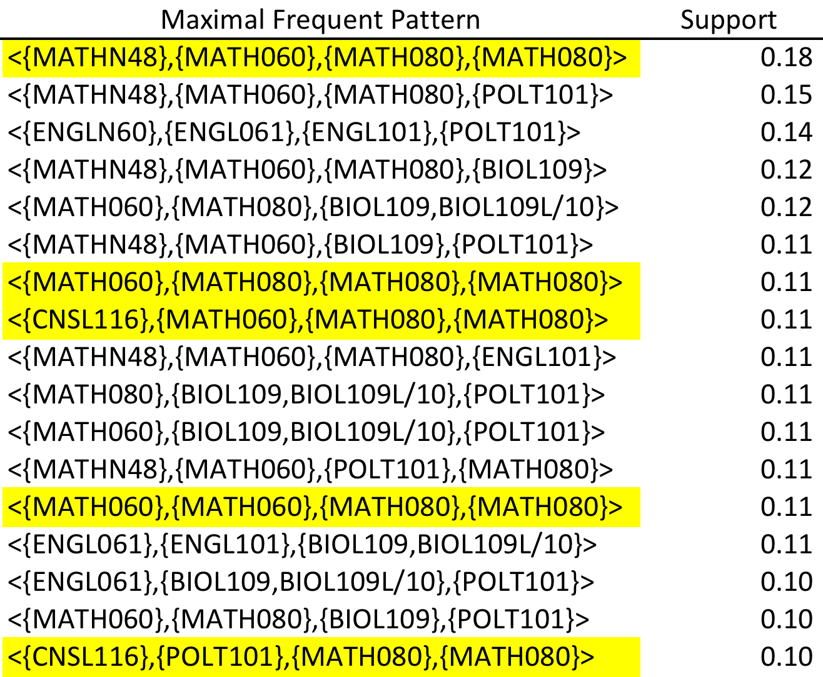
Frequent Patterns in CCC Student Course Sequences
Santa Ana
Notes:
Repeat MATH060, MATH080

Slide 23
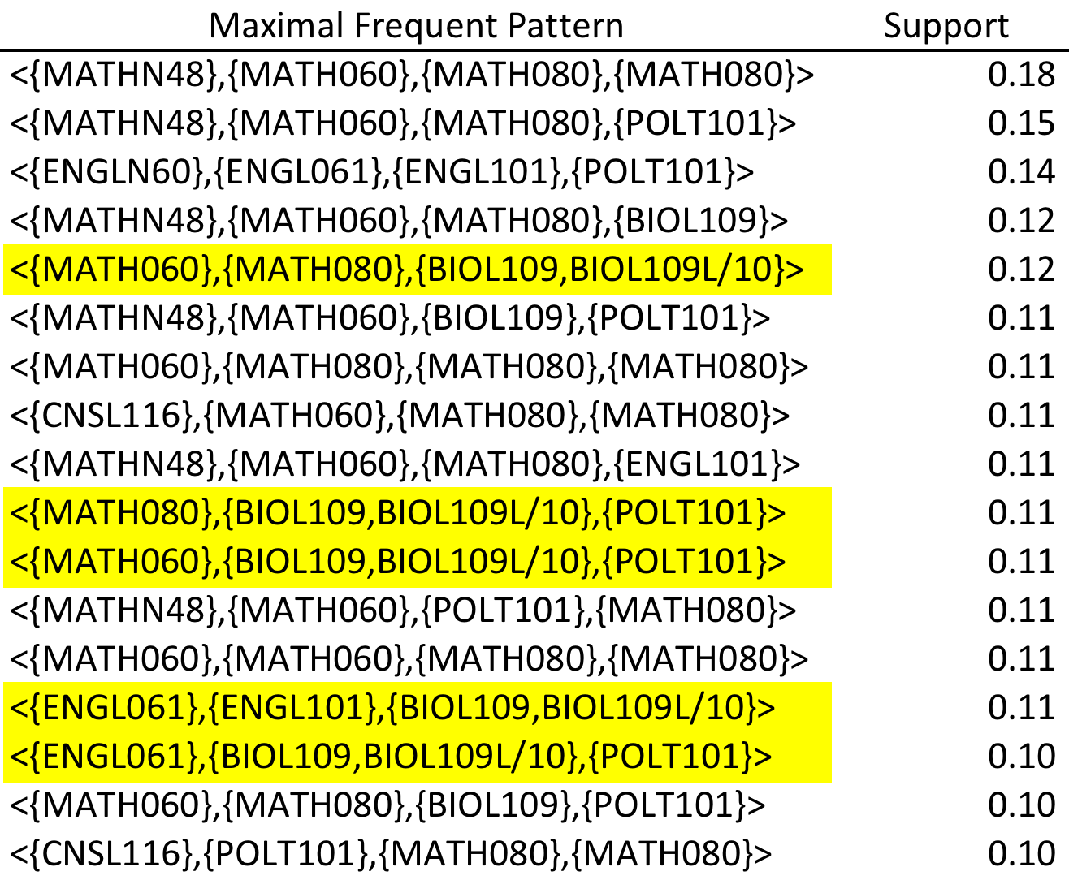
Frequent Patterns in CCC Student Course Sequences
Santa Ana
Notes:
BIOL109 and BIOL109 Lab taken together

Slide 24
Frequent Patterns in CCC Student Course Sequences
Discussion

Slide 25
Frequent Patterns in CCC Student Course Sequences
Results were unexpected
“What we have found, in all the labs that we have studied, is that over half of the findings that scientists obtain are unexpected. Thus, one important problem that scientists must cope with is both interpreting the unexpected findings and deciding what to do next. Scientists’ initial reaction to an unexpected finding is that the finding is due to some sort of methodological error” (Dunbar, 2001, p. 317).

Slide 26
Frequent Patterns in CCC Student Course Sequences
Verification of assumptions (Slide 7)
Departments do offer courses in sequences.
Transfer-oriented students did not enroll in sequences of courses that are transferable to a major subject in a baccalaureate program. Instead, they seemed to enroll in introductory courses in many different subjects.
Students with similar interests did not form informal cohorts. Instead, they seemed to go their separate ways.

Slide 27
Frequent Patterns in CCC Student Course Sequences
Frequent courses in MFPs
Basic skills math (pre-algebra, elementary algebra, and intermediate algebra)
Basic skills English (two-course sequence of pre-transfer reading and composition)
public speaking
freshman English
critical thinking
US history
US government
introduction to psychology
introduction to sociology
introduction to statistics

Slide 28
Frequent Patterns in CCC Student Course Sequences
Basic skills
Repeated basic skills math courses
Gaps in basic skills sequences
Enrolled in basic skills math and English sequentially rather that concurrently
Which subject, math or English, came first varied by campus

Slide 29
Frequent Patterns in CCC Student Course Sequences
Related Literature

Slide 30
Frequent Patterns in CCC Student Course Sequences
“Dispersal of first-time students is one of the distinguishing, but often unnoted, characteristics of the community college and possibly one of several reasons why there is so little community among the students. There is no broad common first year, or even first semester, experience for the new students. Though the colleges are not perceived as unfriendly, there are relatively few social bonds between the students, few participate together in campus organizations, and little leisure time is spent with each other on campus” (Maxwell et al., 2003, p. 39).

Slide 31
Frequent Patterns in CCC Student Course Sequences
“One of the more revealing findings was that just over 50% of all courses taken by our sample were remedial, indicating that they are spending half of their time taking non-transferable college-level courses. In other words, the transfer students in this sample averaged enrolling in courses over a five-year time span but transferred only the equivalent of one year’s worth of full time study credits” (Melguizo, Hagedorn, & Cypers, 2008, p. 417).

Slide 32
Frequent Patterns in CCC Student Course Sequences
“Many younger students entering community colleges from high schools are ‘experimenters,’ unsure about the relationship between schooling and their aspirations. Such students come to community colleges because they are low-cost and convenient places for generating more information about their career and educational options. These students, however, usually develop information by taking courses almost at random, and this is not necessarily an effective route” (Grubb, 2006, p. 197).

Slide 33
Frequent Patterns in CCC Student Course Sequences
“At a community college, any given student is relatively unlikely to be following exactly the same path as another – and even students who do follow the same path may be unlikely to know it” (Scott-Clayton, 2011, p. 14).

Slide 34
Frequent Patterns in CCC Student Course Sequences
Summary

Slide 35
Frequent Patterns in CCC Student Course Sequences
The sequence in which courses were taken was important for pre-transfer courses in math and English.
The course sequence was not important for transfer courses because students rarely took more than one or two courses in the same subject.
One reason that transfer-oriented students lingered at community college was difficulty completing the pre-transfer courses in math and English.
Students enrolled in a great variety of courses, many of which had three or fewer students from the sample.

Slide 36
Frequent Patterns in CCC Student Course Sequences
Acknowledgements
I thank Patrick Perry and the Chancellor’s Office of the California Community Colleges for granting permission to use the data employed in this study and authorizing Peter Bahr to provide these data.
I am also greatly indebted to Peter Bahr at the University of Michigan for providing data from his previous research.

Slide 37
Frequent Patterns in CCC Student Course Sequences
References

Slide 38
Frequent Patterns in CCC Student Course Sequences
Adelman, C. (2005). Moving into town—and moving on: The community college in the lives of traditional–age students. Retrieved from Washington, DC:
Agrawal, R., & Srikant, R. (1995). Mining sequential patterns. Proceedings of the 1995 International Conference on Data Engineering (pp. 3-14). Taipei, Taiwan.
Ammon, B. V., Bowman, J., & Mourad, R. (2008). Who are our students? Cluster analysis as a tool for understanding community college student populations Journal of Applied Research in the Community College, 16(1), 32-44.
Bahr, P. R. (2010). The bird's eye view of community colleges: A behavioral typology of first-time students based on cluster analytic classification. Research in Higher Education, 51, 724-740.
Bahr, P. R. (2011). A typology of students' use of the community college. New Directions for Institutional Research, Assessment Supplement, 33-48.
Berry, M. J. A., & Linhoff, G. (1997). Data mining techniques: For marketing, sales, and customer support. New York: Wiley.
Boughan, K. (2000). The role of academic process in student achievement: An application of structural equation modeling and cluster analysis to community college longitudinal data. AIR Professional File, 74, 1-17.
Buchta, C., & Hahsler, M. (2012). arulesSequences: Mining frequent sequences (Version 0.2-4)[Computer software]. Retrieved from http://cran.cnr.berkeley.edu
California Community Colleges System Strategic Plan Steering Committee. (2006). California Community Colleges system strategic plan. Sacramento: California Community Colleges Board of Governors.
Dunbar, K. (2001). The analogical paradox: Why analogy is so easy in naturalistic settings, yet so difficult in the psychological laboratory. In D. Gentner, K. J. Holyoak, & B. N. Kokinov (Eds.), The analogical mind: Perspectives from cognitive science. Cambridge, MA: MIT Press.
Grubb, W. N. (2006). "Like, what do I do now?": The dilemmas of guidance counseling. In T. Bailey & V. S. Morest (Eds.), Defending the community college equity agenda. Baltimore: Johns Hopkins University Press.

Slide 39
Frequent Patterns in CCC Student Course Sequences
Hagedorn, L. S., & Prather, G. (2005). The community college solar system: If university students are from Venus community college students must be from Mars. Paper presented at the Annual Forum of the Association of Institutional Research, San Diego, CA.
Hahsler, M., Buchta, C., Grün, B., & Hornik, K. (2010). arules: Mining association rules and frequent itemsets (Version 1.0-14)[Computer software]. Retrieved from http://cran.cnr.berkeley.edu
Hahsler, M., Chelluboina, S., Hornnik, K., & Buchta, C. (2011). The arules R-package ecosystem: Analyzing interesting patterns from large transaction databases. Journal of Machine Learning Research, 12, 2012-2025.
Hahsler, M., Grün, B., & Hornik, K. (2005). arules – A computational environment for mining association rules and frequent itemsets. Journal of Statistical Software, 14(12), 1-25.
Hand, D., Mannila, H., & Smyth, P. (2001). Principles of data mining. Cambridge, MA: MIT Press.
Horn, L., & Weko, T. (2009). On track to complete? A taxonomy of beginning community college students and their outcomes 3 years after enrolling: 2003–04 through 2006 (NCES 2009-152). Retrieved from Washington, DC:
Maxwell, W., Hagedorn, L. S., Cypers, S., Moon, H. S., Brocato, P., Wahl, K., & Prather, G. (2003). Community and diversity in urban community colleges: Coursetaking among entering students. Community College Review, 30(4), 21-46.
Melguizo, T., Hagedorn, L. S., & Cypers, S. (2008). Remedial/developmental education and the cost of transfer: A Los Angeles county sample The Review of Higher Education, 31(4), 401-431.
Ng, R. T., Lakshmanan, L. V. S., Han, J., & Pang, A. (1998). Exploratory mining and pruning optimizations of constrained associations rules. Paper presented at the 1998 ACM SIGMOD international conference on Management of data, Seattle, Washington, USA.
Scott-Clayton, J. (2011). The shapeless river: Does a lack of structure inhibit students' progress at community colleges? (CCRC Working Paper No. 25). New York: Columbia University, Teachers College, Community College Research Center.

Slide 40
Frequent Patterns in CCC Student Course Sequences
Questions?

Slide 41
Frequent Patterns in CCC Student Course Sequences
Contact information
ingraham@cal.berkeley.edu
415-377-4068

