Slide 1
Creating Ad Hoc Interactive Excel Dashboards in Support of Enrollment Management Planning and Decision Making
Presentation to CAIR: November 5, 2015
By Pete Van Hamersveld, Associate Director
Institutional Research, CSU Dominguez Hills

Slide 2
Goal of presentation
Show examples of dashboards utilizing basic Excel tools
Explain how key components were constructed
Discuss On-Line Resources

Slide 3
Background
Why I started creating ad hoc dashboards to support enrollment management decision making?
Projections vs. Calculations:

Slide 4
Slider Bar
Example of dashboards build around a simple slider bar

Slide 5
Context
Show CY enrollment scenarios during Fall representing different percentages over the Chancellor’s Office CY target for the campus
and what that would look like for the coming spring.

Slide 6
What a static table would have looked like:

Slide 7
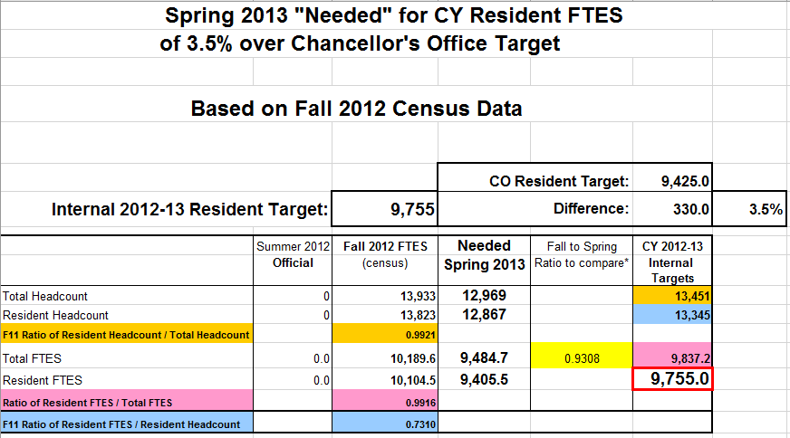
What a static table would have looked like:

Slide 8
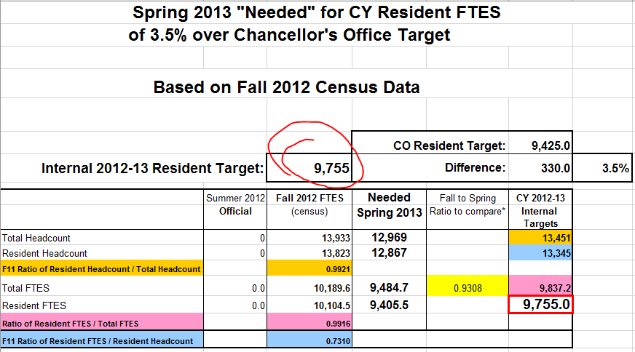
What a static table would have looked like:

Slide 9
Adding a simple scroll bar makes it a dynamic table:

Slide 10
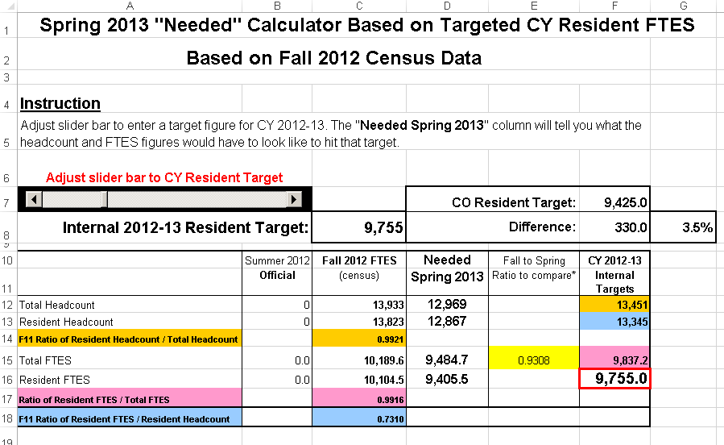
Adding a simple scroll bar makes it a dynamic table:

Slide 11
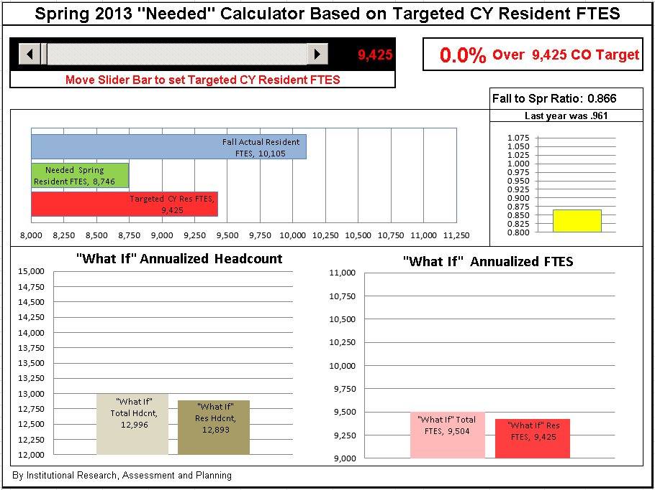

Slide 13
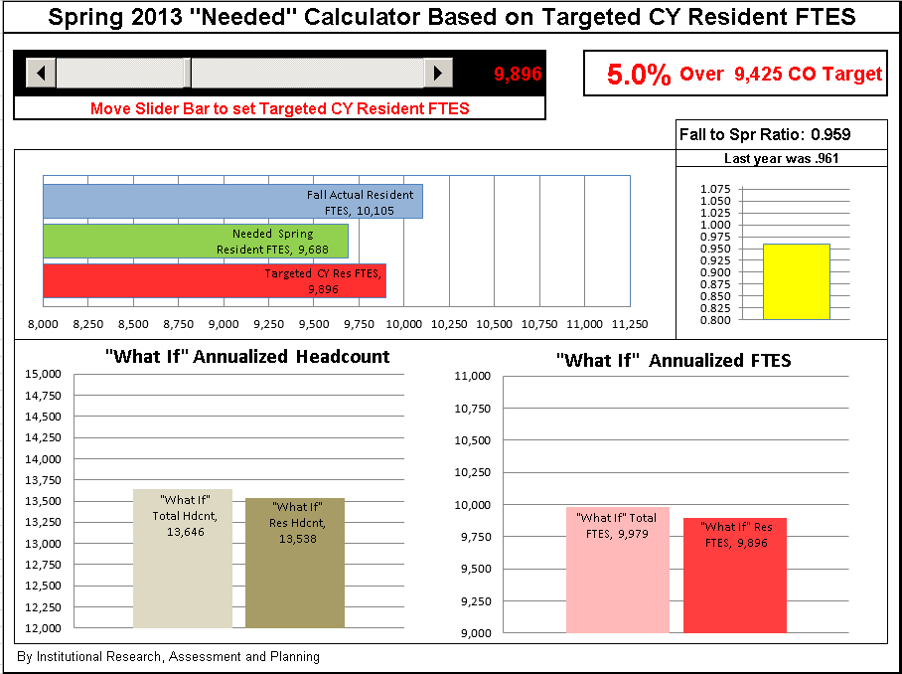

Slide 14
Context
Planning upcoming CY enrollment capacity by college taking into consideration the impact of various possible spring enrollment restrictions.

Slide 15
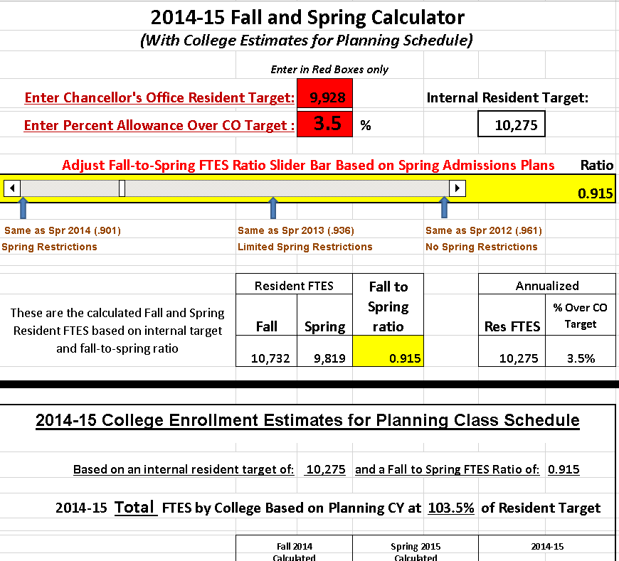

Slide 16
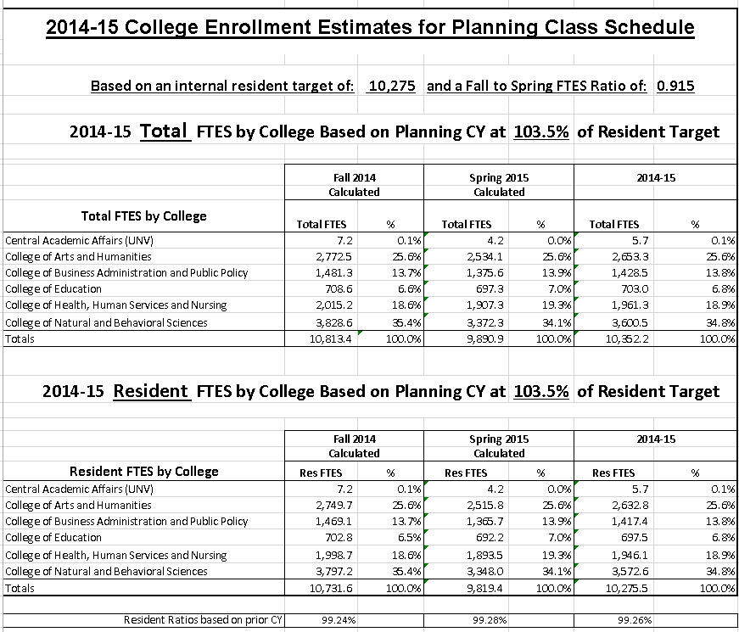

Slide 17
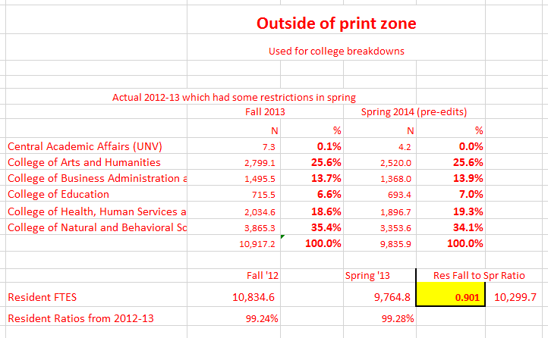

Slide 18
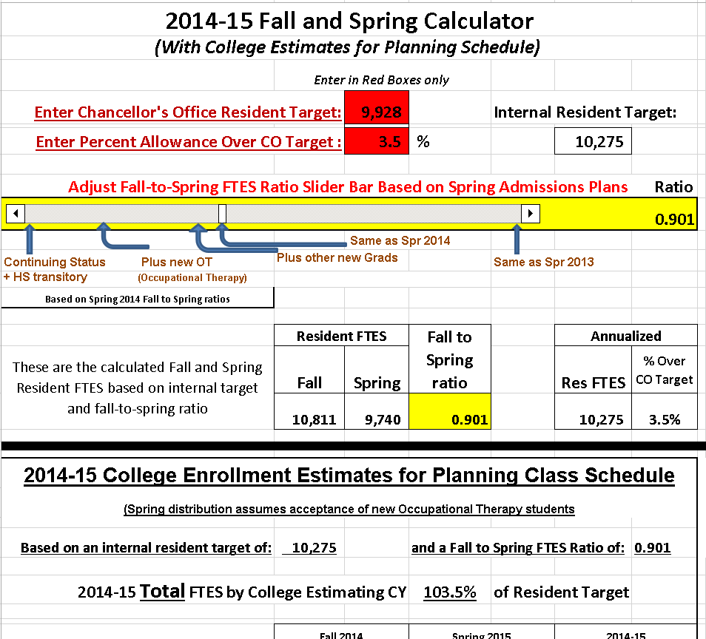

Slide 19
These powerful dashboards were built around a very simple slider bar.
Let’s see just how simple it is!

Slide 20
Include “Developer” tab in ribbon

Slide 22
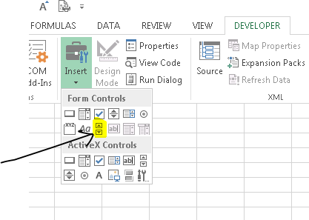
Click “Insert,” then slider icon. Then click anywhere on the spreadsheet for the slider bar to appear.

Slide 23
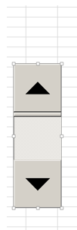
After slider appears, right click to set up the Form Control.

Slide 24
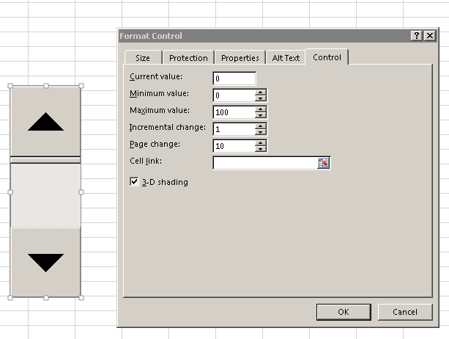
After slider appears, right click to set up the Form Control.
Initialized a number
Specify cell to populate with number
Sets numeric range of slider

Slide 25
Adjusting the slider changes the value in the designated box

Slide 27
SUMIFS
Example of using SUMIFS to add figures for categories within a date range.

Slide 28
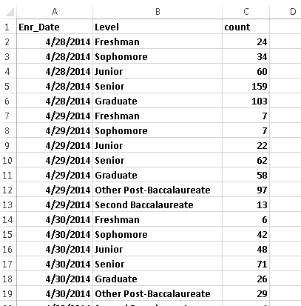
Census Enrollments by Date First Registered

Slide 29
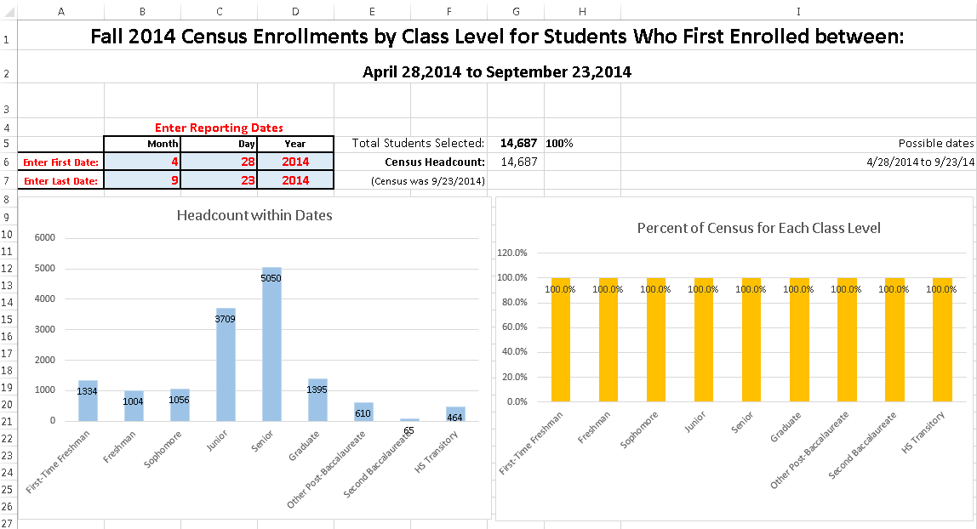

Slide 30
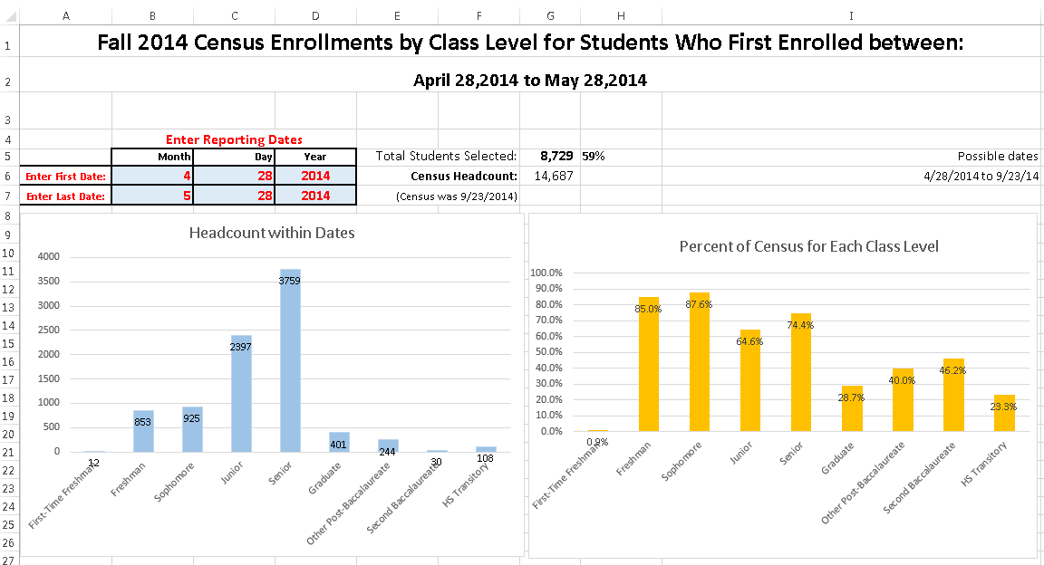

Slide 31
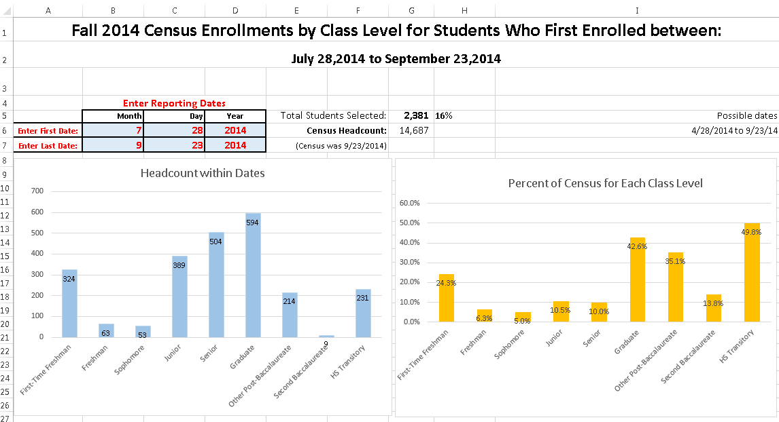

Slide 32
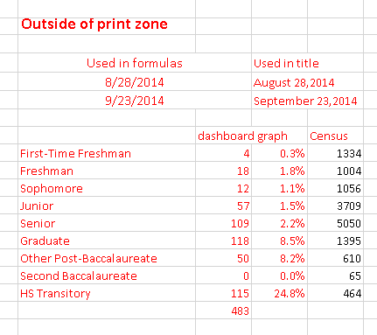

Slide 33
SUMIFS and VLOOK
Example of using SUMIFS to add figures for categories within a date range
Where some categories are collapsed variables based on a lookup table

Slide 34
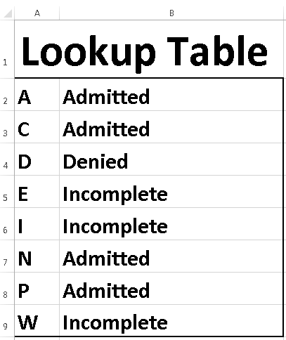

Slide 35
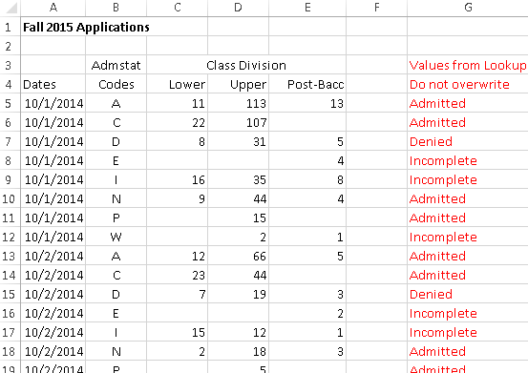

Slide 36
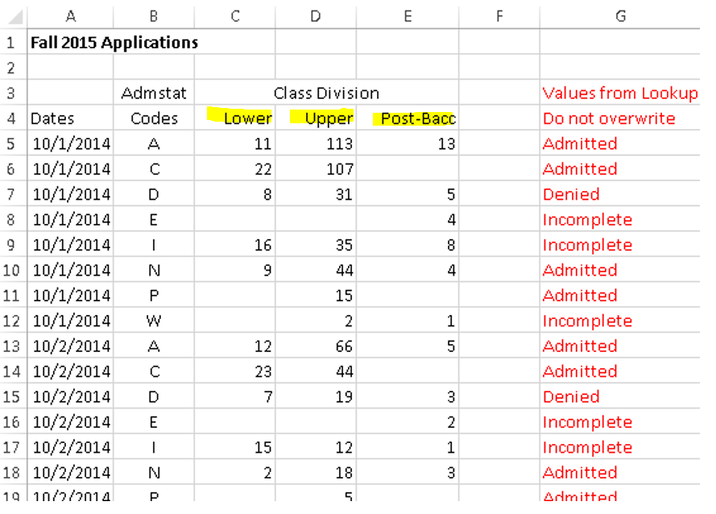

Slide 37
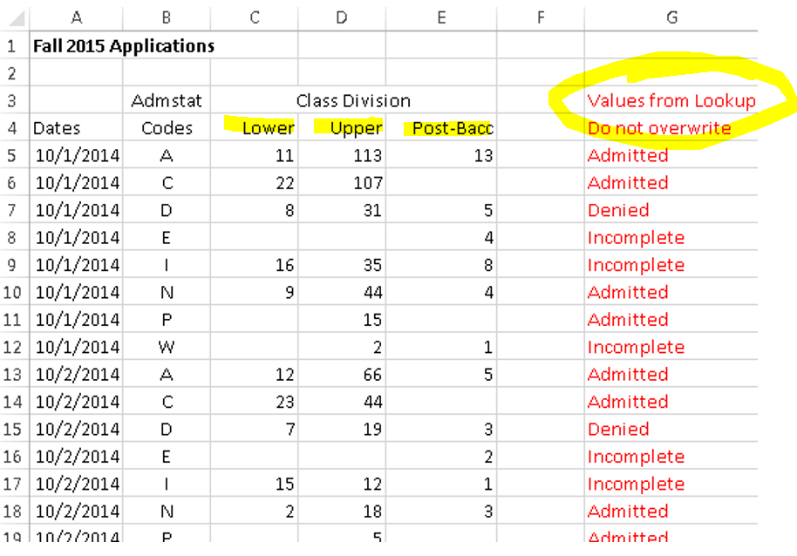

Slide 38
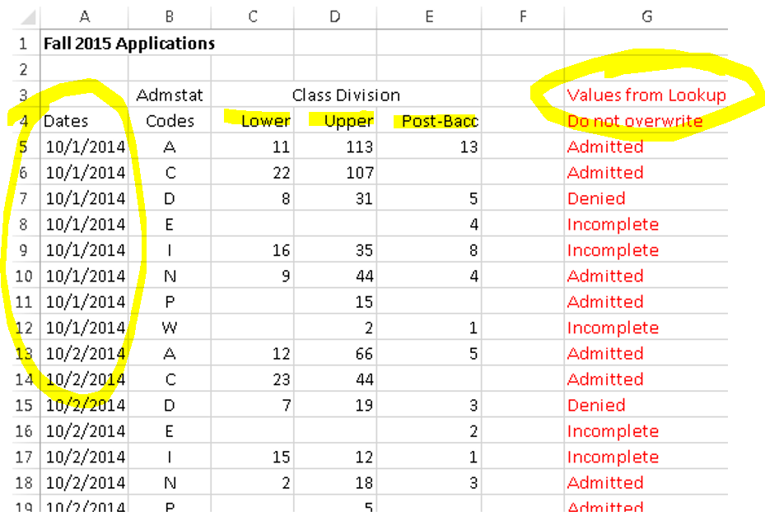

Slide 39
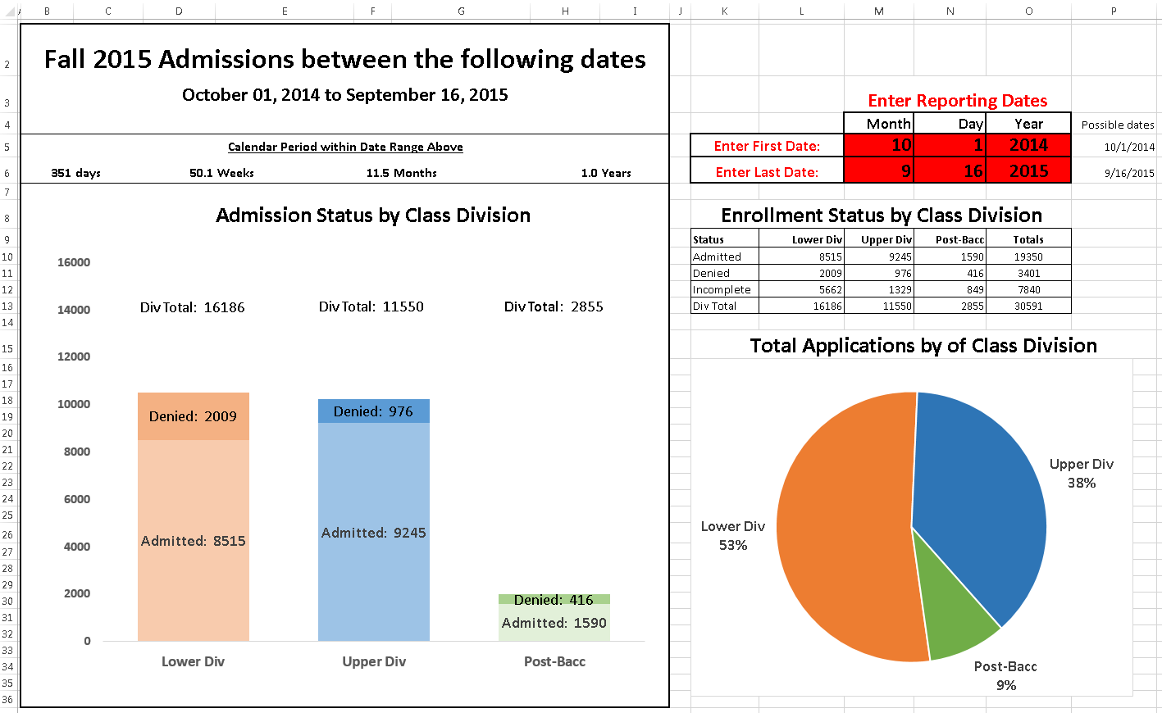

Slide 40
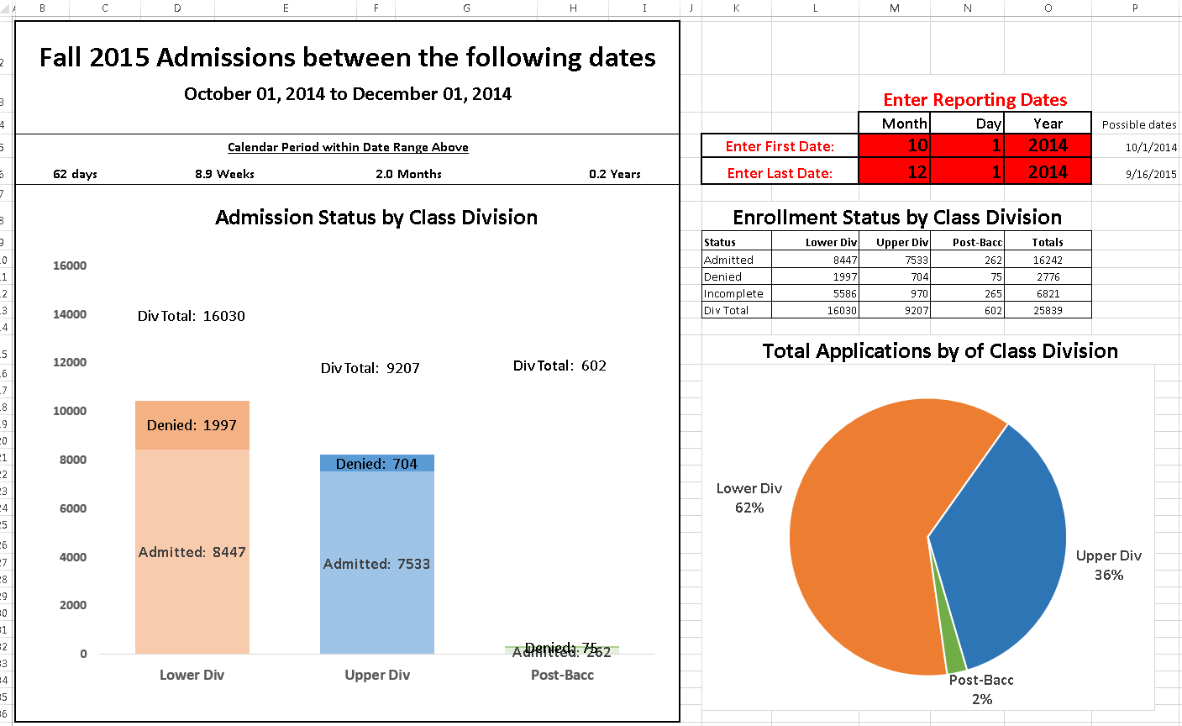

Slide 41
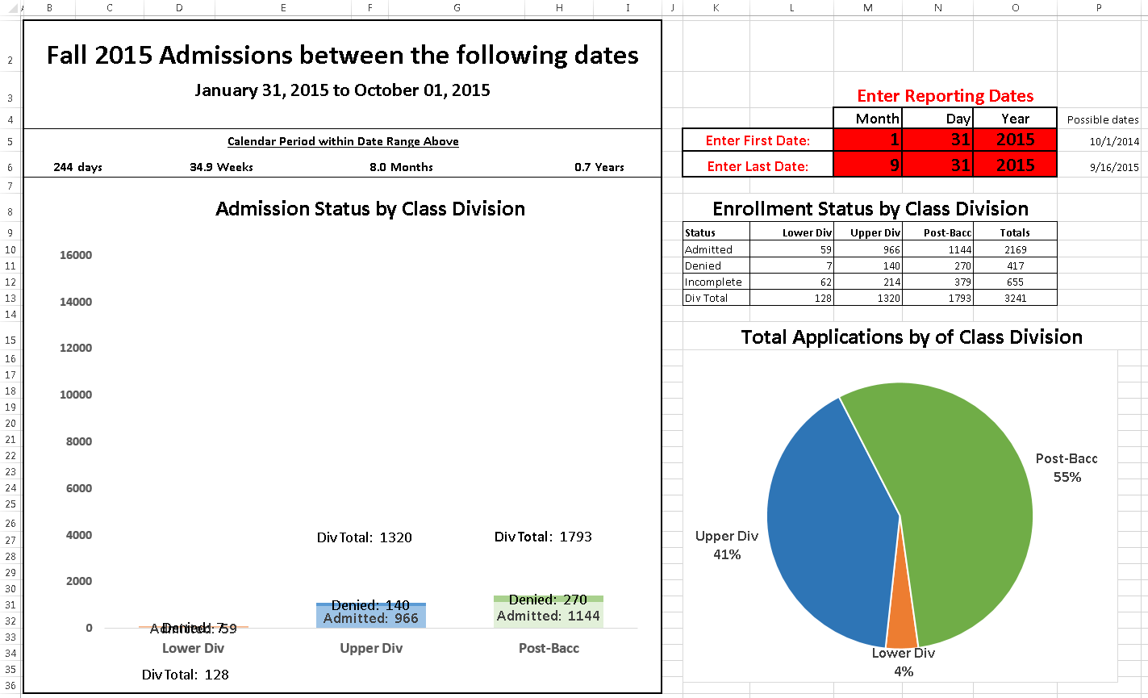

Slide 42
Constructing the SUMIFS code

Slide 43
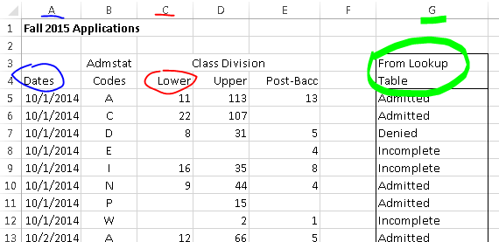

Slide 44
This is done interactively:

Slide 45
This is done interactively:
Basically, Sum the Lower Division column in the “Data” tab
for corresponding dates in the “Data” tab that are within the two date ranges in the “Graph” tab, while selecting for records in the “Data” tab corresponding to the Admission Status label in the “Graph” tab (lookup cell). Relative cell referencing ($) facilitates copying to other cells.

Slide 46
On-Line Resources

Slide 47
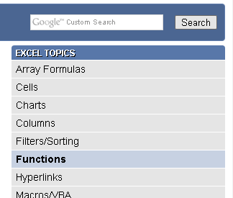
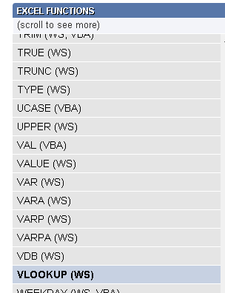
http://www.techonthenet.com
http://www.techonthenet.com/excel/formulas/vlookup.php

Slide 48
http://blog.contextures.com
Date Range and SUMIF
http://blog.contextures.com/archives/2013/02/26/sum-for-a-date-range-in-excel/

Slide 49
http://peltiertech.com
Creating totals in stacked bars
http://peltiertech.com/label-totals-on-stacked-charts/

Slide 50
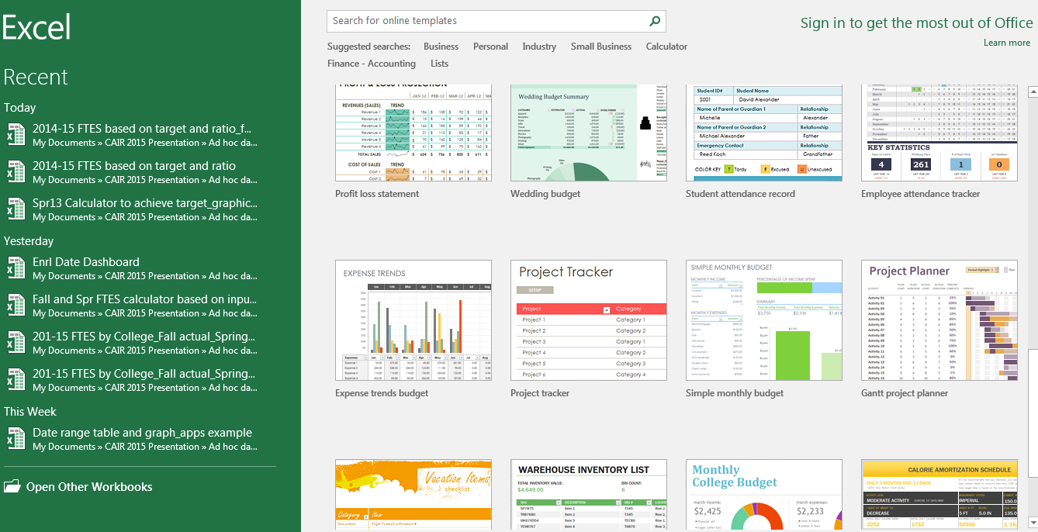

Slide 51
Time for questions or discussion

