Slide 1
Using Instrumental Variables (IV) Analysis in Institutional Research & Program Evaluation
Gary Pike
Higher Education & Student Affairs
Indiana University School of Education

Slide 2
Introductions
Who are you?
What do you do?
Why are you here?
What is your background/experience?

Slide 3
Overview
Introductions
The role of IV in institutional research
  The role of regression in IR
  Omitted variable bias
  Using IV analysis to account for omitted variable bias
  Stata example: College and Civic Engagement
Using IV in program evaluation
  A primer on causal inference
  Using IV analysis in quasi-experimental designs
  Stata example: The Effect of a Grants Program on 9th Grade Attainment
  Another Stata example: Fifteen-to-Finish

Slide 4
Using Instrumental Variables in Institutional Research

Slide 5
Regression in IR
Regression is the workhorse of institutional research.
  Predicted GPA for admission standards.
  Role of financial aid in retention and graduation.
  Examining the possible impact of “Fifteen-to-Finish.”
  Evaluation of freshman interest groups.
  Impact of fraternity/sorority membership.
  Faculty salary studies.

Slide 6
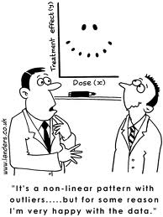
Regression in ER
“… one can hardly pick up an issue of a higher education journal without running across at least one study in which OLS regression was the methodology of choice.” Ethington, Thomas, & Pike (2002).
Of the articles I’ve written in the last 10 years, exactly 2 have not used some form of regression analysis.
  Weighting adjustments in surveys.
  Cluster/factor analysis.

Slide 7
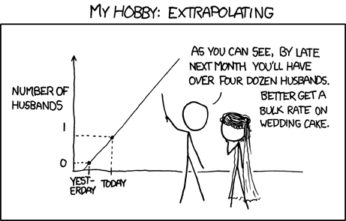
If Regression is so important…
… shouldn’t we get it right?
Unbiased
Consistent
Asymptotically unbiased

Slide 8

The Basic Regression Model
    $$Y_{i}=β_{0}+β_{1}X_{i1}+β_{2}X_{i2}+ …+β_{m}X_{im}+ε_{i}$$

Slide 9
Regression Assumptions
Linearity
Normality
Homogeneity of Variance
Fixed “X”
Independence
  COV[X₁, ε] = 0

Slide 10

The Omitted Variable Problem
Population
$$GPA= β_{0}+\left(β_{1}∗SAT\right)+\left(β_{2}∗HSCPR\right)+ε$$
Sample
$$GPA= β_{0}+\left(β_{1}∗SAT\right)+\left(HSCPR+ ε\right)$$

Slide 11
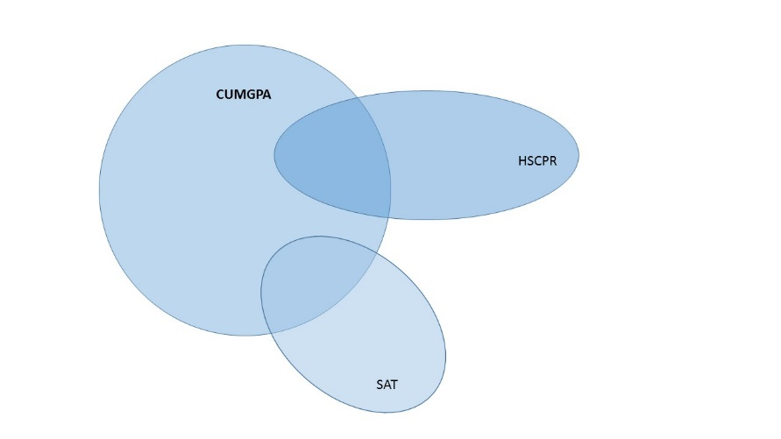
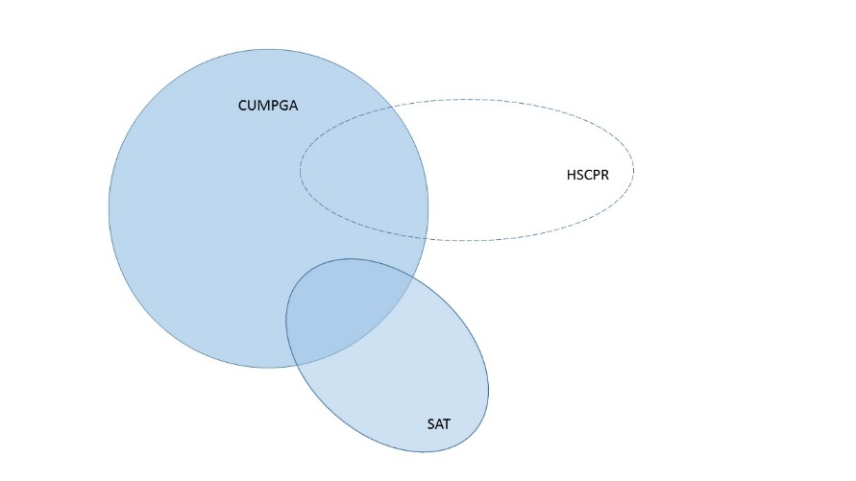
Violating Independence ☺

Slide 12
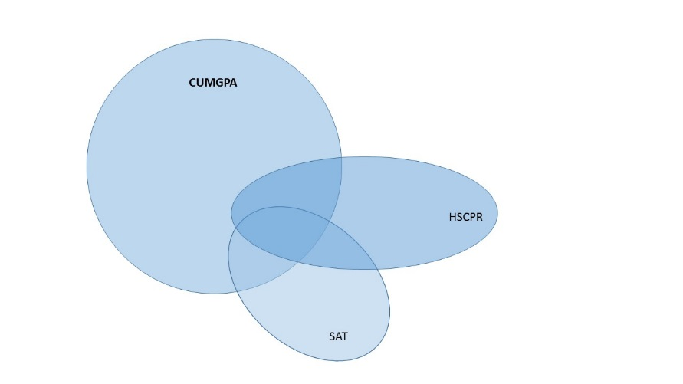
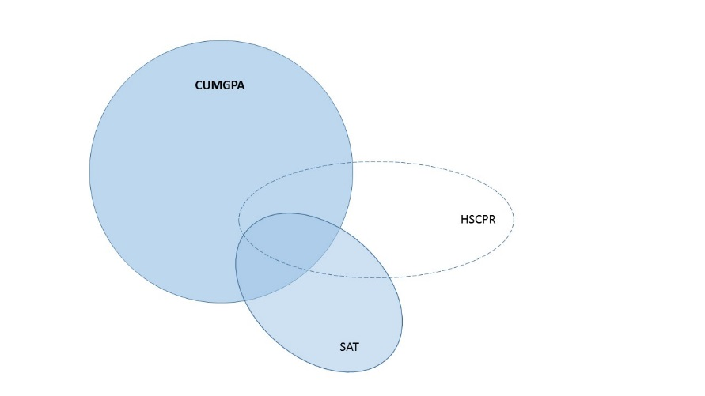
Violating Independence ☹

Slide 13
An Example
(Population Parameters)
cumgpa sat100 hscpr10
cumgpa 1.0000
sat100 0.2421 1.0000
hscpr10 0.3527 0.3209 1.0000
Coef. Std. Err. t P>|t| Beta
sat100 .0912693 .011383 8.02 0.000 .1436923
hscpr10 .1495391 .008741 17.11 0.000 .306591
cons .6490922 .1104643 5.88 0.000 .

Slide 14
The Results
GPA Revisited
Coef. Std. Err. t P>|t| Beta
sat100 .0912693 .011383 8.02 0.000 .1436923
hscpr10 .1495391 .008741 17.11 0.000 .306591
cons .6490922 .1104643 5.88 0.000 .
Coef. Std. Err. t P>|t| Beta
sat100 .1537625 .011297 13.61 0.000 .2420802
_cons 1.004802 .113682 8.84 0.000 .

Slide 15
Stata Interlude 1

Slide 16
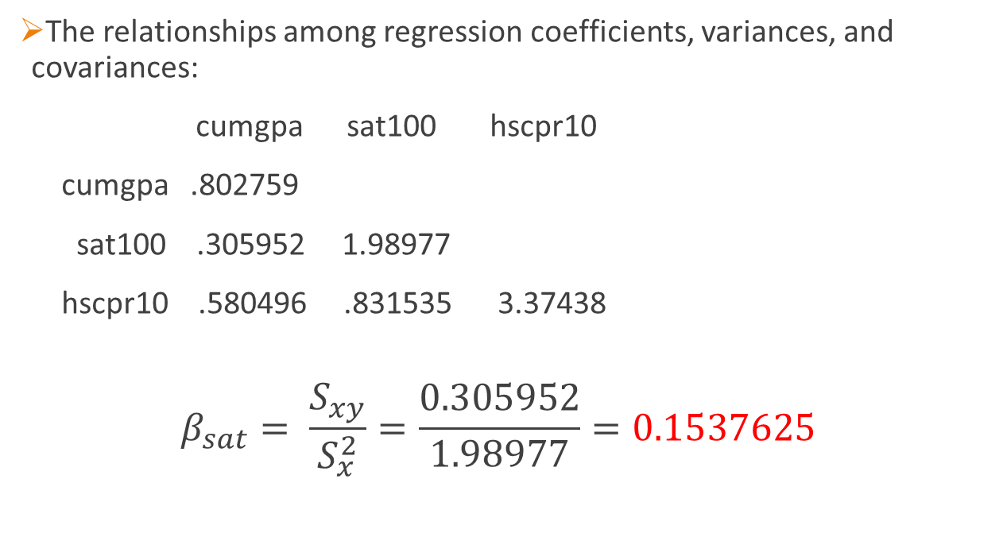
A Note from the Interlude
The relationships among regression coefficients, variances, and covariances:
cumgpa sat100 hscpr10
cumgpa .802759
sat100 .305952 1.98977
hscpr10 .580496 .831535 3.37438
  $$β_{sat}= \frac{S_{xy}}{S_{x}^{2}}=\frac{0.305952}{1.98977}=0.1537625$$

Slide 17
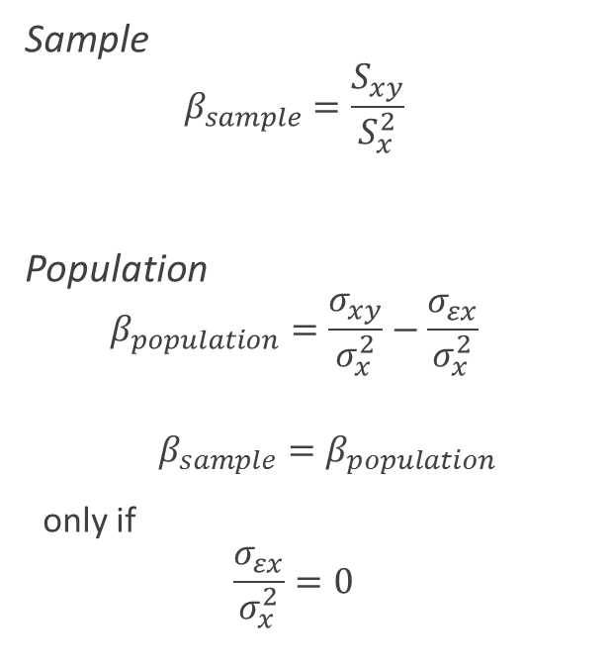
From Sample to Population
Sample
  $$β_{sample}=\frac{S_{xy}}{S_{x}^{2}}$$
Population
  $$β_{population}=\frac{σ_{xy}}{σ_{x}^{2}}−\frac{σ_{εx}}{σ_{x}^{2}}$$
  $β_{sample}=β_{population}$
  only if
  $$\frac{σ_{εx}}{σ_{x}^{2}}=0$$

Slide 18
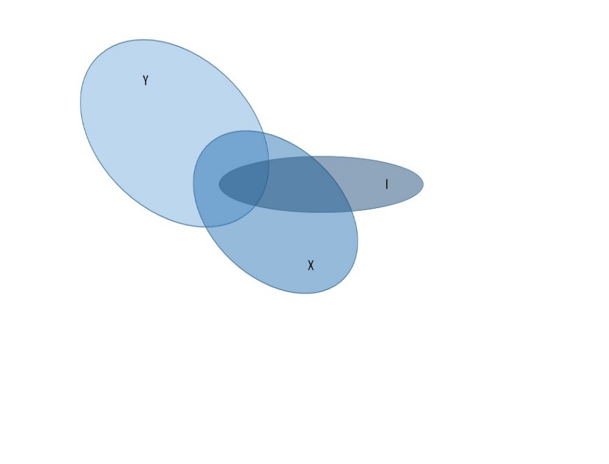
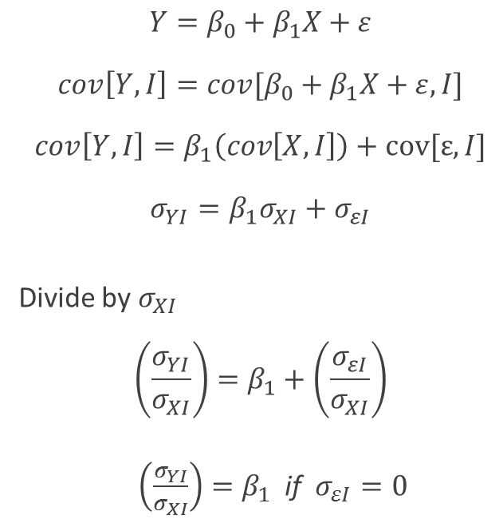
How Instrumental Variables Work
$$Y=β_{0}+β_{1}X+ε$$
$$cov\left[Y,I\right]=cov[β_{0}+β_{1}X+ε, I]$$
$$cov\left[Y,I\right]=β_{1}\left(cov\left[X,I\right]\right)+cov[ε,I]$$
$$σ_{YI}=β_{1}σ_{XI}+σ_{εI}$$
Divide by $σ_{XI}$
$$\left(\frac{σ_{YI}}{σ_{XI}}\right)=β_{1}+\left(\frac{σ_{εI}}{σ_{XI}}\right)$$
$\left(\frac{σ_{YI}}{σ_{XI}}\right)=β_{1}$ if $σ_{εI}=0$

Slide 19

To be an Instrument (I)
The instrument (I) must be strongly related to (correlated with) the explanatory variable (X).
The instrument (I) must be unrelated to (not correlated with) the error term (ε).
Alternatively
The instrument (I) must be related to the outcome variable (Y) only through the explanatory variable (X).

Slide 20
Stata Interlude 2
Dee’s (2004) study of the effects of attending college on civic engagement (registering to vote).

Slide 21
First-stage regressions
-----------------------
Number of obs = 9227
F( 1, 9225) = 115.86
Prob > F = 0.0000
R-squared = 0.0124
Adj R-squared = 0.0123
Root MSE = 0.4947
------------------------------------------------------------------------------
college | Coef. Std. Err. t P>|t| [95% Conf. Interval]
-------------+----------------------------------------------------------------
distance | -.006371 .0005919 -10.76 0.000 -.0075312 -.0052108
_cons | .6091178 .0077287 78.81 0.000 .5939678 .6242678
------------------------------------------------------------------------------
Instrumental variables (2SLS) regression Number of obs = 9227
Wald chi2(1) = 10.57
Prob > chi2 = 0.0011
R-squared = 0.0223
Root MSE = .46462
------------------------------------------------------------------------------
register | Coef. Std. Err. z P>|z| [95% Conf. Interval]
-------------+----------------------------------------------------------------
college | .2836913 .0872481 3.25 0.001 .1126882 .4546944
_cons | .5156526 .047977 10.75 0.000 .4216194 .6096858
------------------------------------------------------------------------------
Instrumented: college
Instruments: distance
cov[Y,I] = -0.1369; cov[X,I] = -0.4825; -0.1369 / -0.4825 = 0.2837

Slide 22
Testing the Assumptions of IV
The instrument must be related to the explanatory variable.
  In our example, we have an F-test showing the relationship between the instrument (distance from a college) and the explanatory variable (whether the student attended college: F=115.86; df=1, 9225; p < 0.05.
  Stock, Wright, and Yugo (2002) argue that the F-ratio would be greater than 10. (Two or more instruments require larger F-ratios.)
There is no path linking the instrument directly to the outcome.
I
X
Y

Slide 23
Adding Covariates
Frequently want to add covariates to our models
  These covariate may help to account for some of the relationship between the outcome and the explanatory variable.
  They provide a better explanation of the outcome, and thereby increase the power/efficiency of estimation.
  Another reason to include covariates is to address the “no third path” requirement. (Dee included race/ethnicity & achievement test scores.)
When covariates are present, the instrument needs to be related to the explanatory variable above and beyond the relationships of the covariates to the explanatory variable.
In addition to not being directly related to the outcome, the instrument should not be related to the outcome through the covariates.

Slide 24
Stata Interlude 3

Slide 25
First-stage regressions
-----------------------
Number of obs = 9227
F( 4, 9222) = 51.24
Prob > F = 0.0000
R-squared = 0.0217
Adj R-squared = 0.0213
Root MSE = 0.4925
------------------------------------------------------------------------------
college | Coef. Std. Err. t P>|t| [95% Conf. Interval]
-------------+----------------------------------------------------------------
black | -.057663 .015959 -3.61 0.000 -.0889461 -.0263799
hispanic | -.116213 .0132567 -8.77 0.000 -.1421991 -.0902269
otherrace | .0337076 .0240104 1.40 0.160 -.0133582 .0807734
distance | -.0069203 .0005947 -11.64 0.000 -.0080861 -.0057545
_cons | .643146 .0090535 71.04 0.000 .6253992 .6608929
------------------------------------------------------------------------------

Slide 26
Instrumental variables (2SLS) regression Number of obs = 9227
Wald chi2(4) = 43.44
Prob > chi2 = 0.0000
R-squared = 0.0345
Root MSE = .46174
------------------------------------------------------------------------------
register | Coef. Std. Err. z P>|z| [95% Conf. Interval]
-------------+----------------------------------------------------------------
college | .2488616 .0805791 3.09 0.002 .0909294 .4067937
black | .061733 .0151694 4.07 0.000 .0320015 .0914646
hispanic | .0282926 .0148281 1.91 0.056 -.0007699 .0573552
otherrace | -.1066661 .0228131 -4.68 0.000 -.151379 -.0619532
_cons | .5266 .0462939 11.38 0.000 .4358655 .6173344
------------------------------------------------------------------------------
Instrumented: college
Instruments: black hispanic otherrace distance

Slide 27
Adding Instruments
Only having a single instrument (e.g., distance) is problematic because there is no test of the “no third path” assumption.
  If there are more instruments in the model than there are explanatory variables, the model is “over-identified” and there are statistical tests that can be used to evaluate whether there are (1) direct paths between the instruments and the outcome, and/or (2) whether the instruments are related to the outcome through the covariates.
  In Dee’s study, he used the number of schools within a 35 mile radius of a student’s high school as a second instrument. (Unfortunately that variable isn’t available in the public-use dataset.)
Alternatively, I’m going to use sex (i.e., female) as the second instrument.

Slide 28
Stata Interlude 4

Slide 29
First-stage regressions
-----------------------
Number of obs = 9227
F( 5, 9221) = 43.16
Prob > F = 0.0000
R-squared = 0.0229
Adj R-squared = 0.0223
Root MSE = 0.4922
------------------------------------------------------------------------------
college | Coef. Std. Err. t P>|t| [95% Conf. Interval]
-------------+----------------------------------------------------------------
black | -.0579896 .0159509 -3.64 0.000 -.0892569 -.0267222
hispanic | -.1155749 .0132513 -8.72 0.000 -.1415503 -.0895995
otherrace | .0357121 .0240058 1.49 0.137 -.0113446 .0827688
distance | -.0068932 .0005945 -11.59 0.000 -.0080585 -.0057278
female | .0334549 .01026 3.26 0.001 .0133431 .0535667
_cons | .6253948 .0105602 59.22 0.000 .6046945 .646095
------------------------------------------------------------------------------

Slide 30
Instrumental variables (2SLS) regression Number of obs = 9227
Wald chi2(4) = 44.86
Prob > chi2 = 0.0000
R-squared = 0.0330
Root MSE = .46208
------------------------------------------------------------------------------
register | Coef. Std. Err. z P>|z| [95% Conf. Interval]
-------------+----------------------------------------------------------------
college | .2576347 .0776504 3.32 0.001 .1054428 .4098266
black | .0620589 .0151592 4.09 0.000 .0323475 .0917703
hispanic | .0291825 .0146742 1.99 0.047 .0004217 .0579433
otherrace | -.1070875 .0228061 -4.70 0.000 -.1517866 -.0623884
_cons | .5216032 .0446415 11.68 0.000 .4341076 .6090989
------------------------------------------------------------------------------
Instrumented: college
Instruments: black hispanic otherrace distance female
. estat overid
Tests of overidentifying restrictions:
Sargan (score) chi2(1) = .162717 (p = 0.6867)
Basmann chi2(1) = .162614 (p = 0.6868)

Slide 31
BREAK

Slide 32
Using Instrumental Variables in Program Evaluation

Slide 33
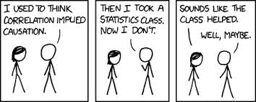
Causal Inference in Program Evaluation
Regression is a correlational procedure, and no matter how many variables you have in the model it’s still correlational.
If we are going to evaluate the effectiveness of education programs and initiatives, I would prefer to say the program “caused” the outcome, rather than saying the program is “correlated” with the outcome.

Slide 34
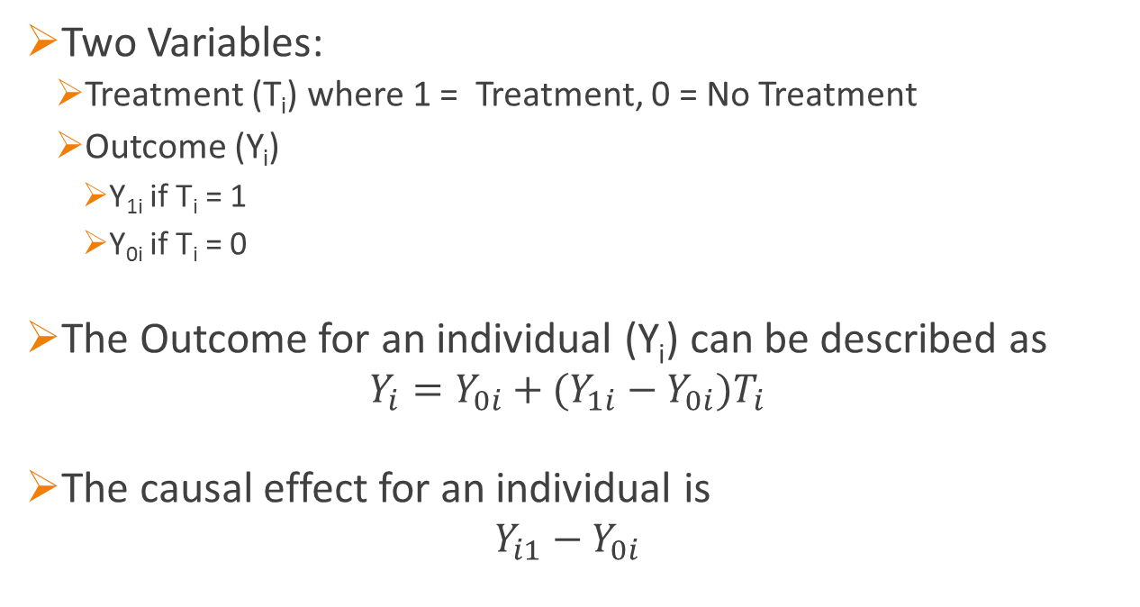
A Quick Tour of Causal Inference
Two Variables:
  Treatment (T_{i}) where 1 = Treatment, 0 = No Treatment
  Outcome (Y_{i})
    Y_{1i} if T_{i} = 1
    Y_{0i} if T_{i} = 0
The Outcome for an individual (Y_{i}) can be described as
  $$Y_{i}=Y_{0i}+(Y_{1i}−Y_{0i})T_{i}$$
The causal effect for an individual is
  $$Y_{i1}−Y_{0i}$$

Slide 35
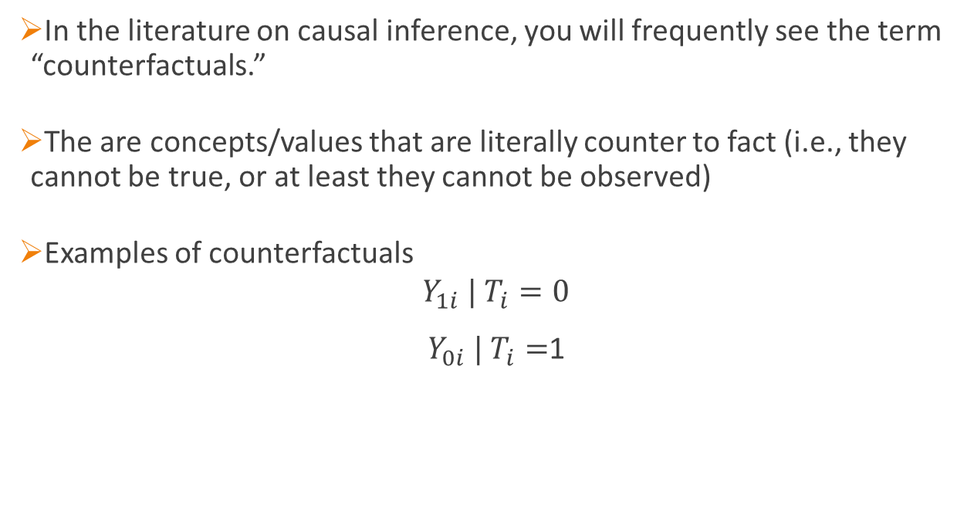
Counterfactuals
In the literature on causal inference, you will frequently see the term “counterfactuals.”
The are concepts/values that are literally counter to fact (i.e., they cannot be true, or at least they cannot be observed)
Examples of counterfactuals
$$Y_{1i} | T_{i}=0$$
$Y_{0i} | T_{i}=$1

Slide 36
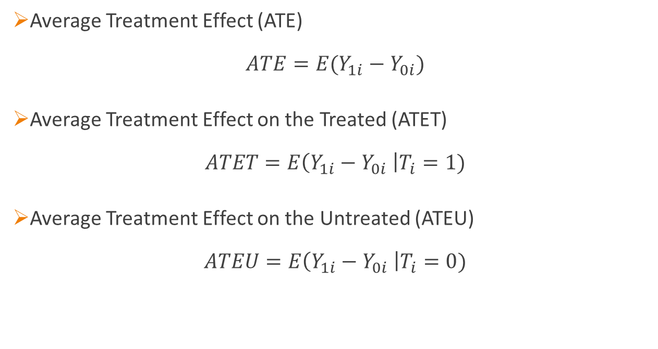
Treatment Effects
Average Treatment Effect (ATE)
$$ATE=E(Y_{1i}−Y_{0i})$$
Average Treatment Effect on the Treated (ATET)
$$ATET=E\left(Y_{1i}−Y_{0i} \right|T_{i}=1)$$
Average Treatment Effect on the Untreated (ATEU)
$$ATEU=E\left(Y_{1i}−Y_{0i} \right|T_{i}=0)$$

Slide 37
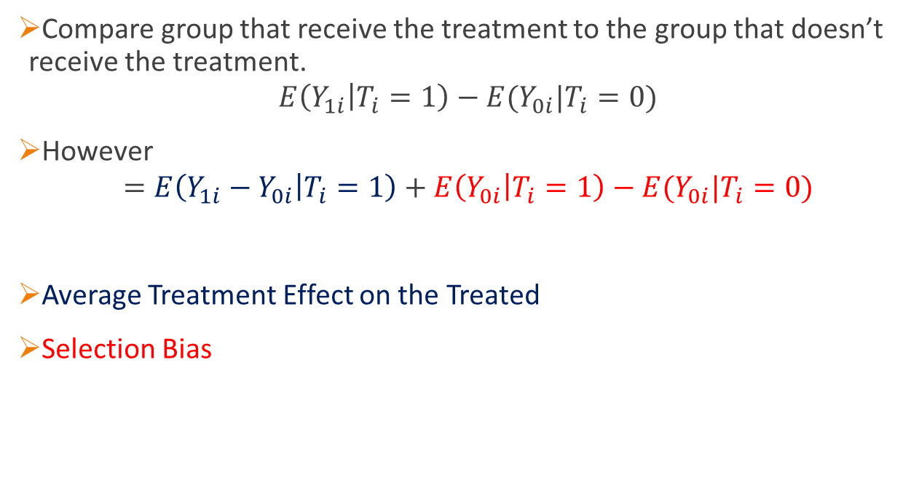
Descriptive Program Evaluation
Compare group that receive the treatment to the group that doesn’t receive the treatment.
$$E\left(Y_{1i} | T_{i}=1\right)−E(Y_{0i}|T_{i}=0)$$
However
$$=E\left(Y_{1i}−Y_{0i} | T_{i}=1\right)+E\left(Y_{0i} | T_{i}=1\right)−E(Y_{0i}|T_{i}=0)$$
Average Treatment Effect on the Treated
Selection Bias

Slide 38
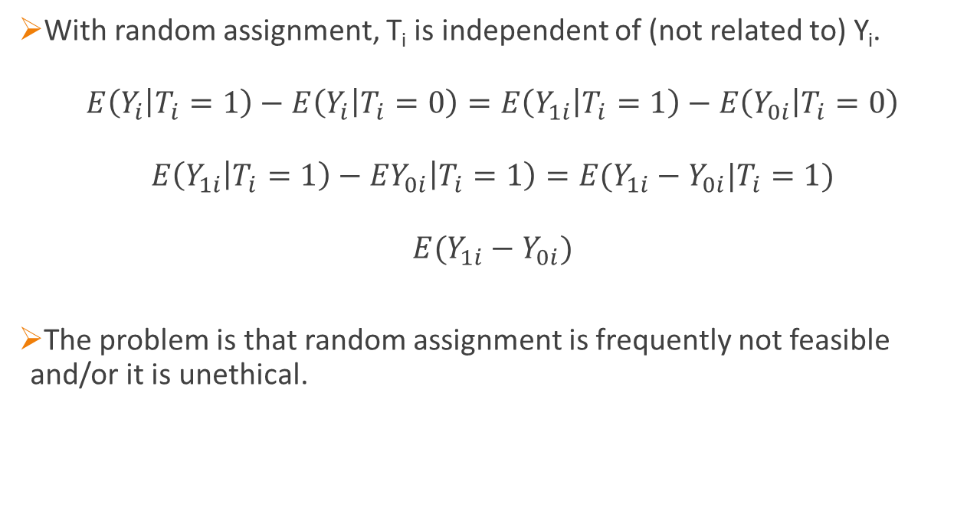
Random Assignment
With random assignment, T_{i} is independent of (not related to) Y_{i}.
$$E\left(Y_{i} | T_{i}=1\right)−E\left(Y_{i} | T_{i}=0\right)=E\left(Y_{1i} | T_{i}=1\right)−E\left(Y_{0i} | T_{i}=0\right)$$
$$E\left(Y_{1i} | T_{i}=1\right)−EY_{0i}\left|T_{i}=1\right)=E(Y_{1i}−Y_{0i}|T_{i}=1)$$
$$E(Y_{1i}−Y_{0i})$$
The problem is that random assignment is frequently not feasible and/or it is unethical.

Slide 39
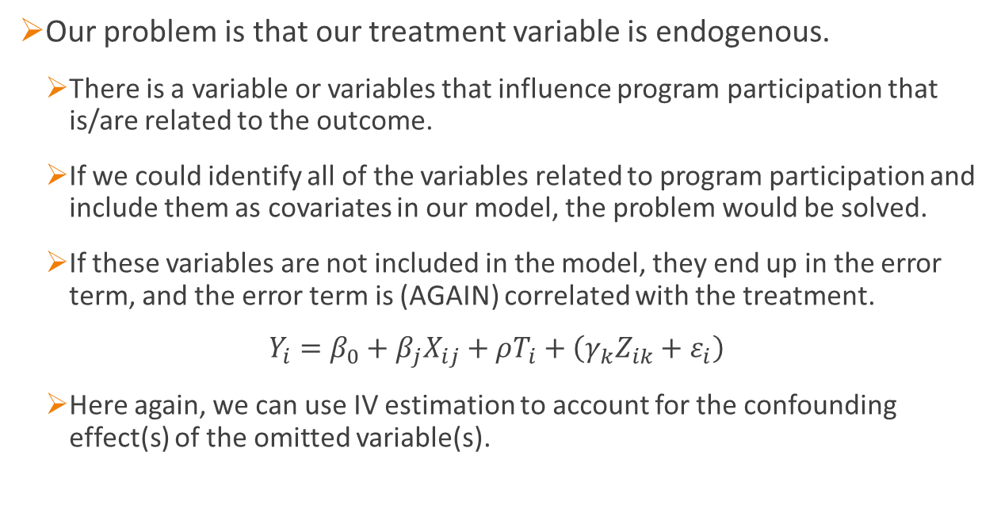
Using Instrumental Variables
Our problem is that our treatment variable is endogenous.
  There is a variable or variables that influence program participation that is/are related to the outcome.
  If we could identify all of the variables related to program participation and include them as covariates in our model, the problem would be solved.
  If these variables are not included in the model, they end up in the error term, and the error term is (AGAIN) correlated with the treatment.
  $$Y_{i}=β_{0}+β_{j}X_{ij}+ρT_{i}+\left(γ_{k}Z_{ik}+ε_{i}\right)$$
  Here again, we can use IV estimation to account for the confounding effect(s) of the omitted variable(s).

Slide 40
However,
An instrumental variables approach can’t be used to estimate the average treatment effect (ATE) for all individuals. In fact, it may not be able to estimate the average treatment effect on the treated (ATET).
Four types of individuals
  Always Takers – They will always participate in the treatment.
  Never Takers – They will never participate in the treatment.
  Defiers – They behave opposite to expectations.
  Compliers – They behave in line with expectations.
Angist & Pischke (2009) note that instrumental variables can be used to estimate treatment effects for compliers—they refer to this as a Local Average Treatment Effect (LATE).

Slide 41
However #2,
There are some additional assumptions we need to satisfy:
  The instrument must be (strongly) related to the treatment variable.
  The instrument must be unrelated to the outcome, except through the treatment (i.e., no third path).
  The influence of the treatment will be the same for all individuals, and individuals not receiving the treatment will not be influenced by individuals receiving the treatment (Stable Unit Treatment Value Assumption, SUTVA).
  The distribution of the instrument across individuals should be comparable to random assignment. As a practical matter, the instrument should be exogenous (0r close to exogenous).
  The instrument has a unidirectional effect on participation in the treatment (monotonicity).

Slide 42
As a Practical Matter ….
An instrumental variables analysis works best when individuals are randomly assigned to a treatment condition, and then some individuals choose not to participate.
Example: Students are randomly assigned to two groups. The first group is invited to join a themed learning community, but the second group is not invited (and cannot) join the learning community.
  Students who are invited to join the theamed learning community are free to decide whether to join the learning community or not.
  The random assignment of students to the learning community invitation group becomes the instrument
  Actually joining the learning community becomes the treatment.
  The outcome might be GPA, and a variety of exogenous covariates related to GPA (e.g., SAT & HS GPA) may be included in the analysis.

Slide 43
Assumptions Revisited
Given that only students who are randomly invited to join the TLC can join the TLC, the relationship between the instrument and the treatment is likely to be strong.
Since students are randomly assigned to the invitation group (instrument), the instrument should not be related to the outcome, except through the treatment.
SUTVA can be a problem. Some students may benefit more from the TLC than others, and there can be spillover. TLC students carry their experiences to non-TLC students.
The instrument is based on random assignment.
We need to be able to assume that there are no defiers in the study.

Slide 44
Stata Interlude 5
Angrist, bettinger,bloom,king, & kremer (2002). A study of the paces scholarship program in bogotá, Columbia.

Slide 45
Variables
Outcome Variable: Did students finish 8th grade (finish8th).
Treatment Variable: Did they participate in the PACES scholarship program (use_fin_aid).
Instrument: Were the students selected to be informed about the PACES scholarship (won_lottry).
Exogenous Covariates:
  Age of the student at the beginning of the study (base_age).
  Sex of the student (male).

Slide 46
Source | SS df MS Number of obs = 1171
-------------+------------------------------ F( 3, 1167) = 26.53
Model | 16.230726 3 5.41024199 Prob > F = 0.0000
Residual | 237.957148 1167 .203905011 R-squared = 0.0639
-------------+------------------------------ Adj R-squared = 0.0614
Total | 254.187874 1170 .217254593 Root MSE = .45156
------------------------------------------------------------------------------
finish8th | Coef. Std. Err. t P>|t| Beta
-------------+----------------------------------------------------------------
use_fin_aid | .1209084 .0268012 4.51 0.000 .1280184
base_age | -.062961 .0098456 -6.39 0.000 -.1819561
male | -.0858505 .0264754 -3.24 0.001 -.0921286
_cons | 1.410283 .1206031 11.69 0.000 .
------------------------------------------------------------------------------

Slide 47
First-stage regressions
-----------------------
Number of obs = 1171
F( 3, 1167) = 346.26
Prob > F = 0.0000
R-squared = 0.4709
Adj R-squared = 0.4696
Root MSE = 0.3594
------------------------------------------------------------------------------
use_fin_aid | Coef. Std. Err. t P>|t| [95% Conf. Interval]
-------------+----------------------------------------------------------------
base_age | -.0151604 .007826 -1.94 0.053 -.0305151 .0001943
male | -.0202571 .02107 -0.96 0.337 -.0615965 .0210823
won_lottry | .674527 .0210141 32.10 0.000 .6332974 .7157567
_cons | .4327598 .0951594 4.55 0.000 .2460573 .6194624
------------------------------------------------------------------------------
Instrumental variables (2SLS) regression Number of obs = 1171
Wald chi2(3) = 75.88
Prob > chi2 = 0.0000
R-squared = 0.0622
Root MSE = .45118
------------------------------------------------------------------------------
finish8th | Coef. Std. Err. z P>|z| [95% Conf. Interval]
-------------+----------------------------------------------------------------
use_fin_aid | .1590002 .0391063 4.07 0.000 .0823532 .2356472
base_age | -.0621574 .0098556 -6.31 0.000 -.0814739 -.0428408
male | -.0851448 .0264583 -3.22 0.001 -.1370021 -.0332875
_cons | 1.378128 .1228792 11.22 0.000 1.137289 1.618966
------------------------------------------------------------------------------
Instrumented: use_fin_aid
Instruments: base_age male won_lottry

Slide 48
Question: Why doesn’t everyone use instrumental variables?
Answer: A good instrument is hard to find!

Slide 49
Example: Fifteen-to-Finish
Dependent Variable: First-year cumulative grade point average (cumgpa).
Treatment: Student enrolled in 15 or more credit hours in the Fall (fifteen).
Covariates:
  SAT (combined) score / divided by 100 (sat100).
  High School Class Percentile Rank / divided by 10 (hscpr10).
  Student is female.
  Underrepresented minority student.
  Hours worked.
Instrument: Student placed in University College. (The lore is that advisors in University College encourage students to take 12-14 credits.)

Slide 50
Source | SS df MS Number of obs = 2554
-------------+------------------------------ F( 6, 2547) = 101.20
Model | 392.047697 6 65.3412828 Prob > F = 0.0000
Residual | 1644.51405 2547 .645667081 R-squared = 0.1925
-------------+------------------------------ Adj R-squared = 0.1906
Total | 2036.56175 2553 .797713181 Root MSE = .80353
------------------------------------------------------------------------------
cumgpa | Coef. Std. Err. t P>|t| Beta
-------------+----------------------------------------------------------------
fifteen | .172259 .0401749 4.29 0.000 .0795047
female | .1028731 .0345814 2.97 0.003 .0560647
sat100 | .0886295 .0129196 6.86 0.000 .1416259
hscpr10 | .1108694 .0087802 12.63 0.000 .2496954
urm | -.3547991 .0469639 -7.55 0.000 -.1409364
hrswork | -.0142094 .0016182 -8.78 0.000 -.1573109
_cons | 1.144642 .1290783 8.87 0.000 .
------------------------------------------------------------------------------

Slide 51
First-stage regressions
-----------------------
Number of obs = 2554
F( 7, 2546) = 45.83
Prob > F = 0.0000
R-squared = 0.1119
Adj R-squared = 0.1095
Root MSE = 0.3890
------------------------------------------------------------------------------
fifteen | Coef. Std. Err. t P>|t| [95% Conf. Interval]
-------------+----------------------------------------------------------------
female | .0382558 .0167855 2.28 0.023 .0053413 .0711704
sat100 | .0290938 .0066129 4.40 0.000 .0161266 .042061
hscpr10 | .0192683 .0043826 4.40 0.000 .0106745 .0278621
urm | -.0116509 .0227885 -0.51 0.609 -.0563368 .0330351
hrswork | -.0035936 .0007837 -4.59 0.000 -.0051304 -.0020567
univcol | -.1900144 .0200152 -9.49 0.000 -.229262 -.1507667
firstgen | -.0413466 .0162137 -2.55 0.011 -.0731399 -.0095532
_cons | .0127673 .0761782 0.17 0.867 -.1366101 .1621448
------------------------------------------------------------------------------

Slide 52
Instrumental variables (2SLS) regression Number of obs = 2554
Wald chi2(6) = 586.31
Prob > chi2 = 0.0000
R-squared = 0.1816
Root MSE = .80785
------------------------------------------------------------------------------
cumgpa | Coef. Std. Err. z P>|z| [95% Conf. Interval]
-------------+----------------------------------------------------------------
fifteen | .4081593 .2103476 1.94 0.052 -.0041144 .820433
female | .0967444 .0351782 2.75 0.006 .0277965 .1656924
sat100 | .076384 .0168387 4.54 0.000 .0433807 .1093873
hscpr10 | .1042121 .0105764 9.85 0.000 .0834827 .1249415
urm | -.350278 .0473813 -7.39 0.000 -.4431436 -.2574124
hrswork | -.0133245 .0018018 -7.40 0.000 -.0168559 -.009793
_cons | 1.244547 .1564727 7.95 0.000 .9378665 1.551228
------------------------------------------------------------------------------
Instrumented: fifteen
Instruments: female sat100 hscpr10 urm hrswork univcol firstgen
Tests of overidentifying restrictions:
Sargan (score) chi2(1) = 12.8117 (p = 0.0003)
Basmann chi2(1) = 12.8359 (p = 0.0003)

Slide 53
Types of Instruments
Identifying appropriate instruments requires a thorough understanding of theory and research related to what you are studying.
You need to understand the setting in which your data were (or will be) obtained.
Types of instruments:
  Proximity of educational institutions;
  Economic conditions (e.g., unemployment rate);
  Institutional rules and personal (demographic) characteristics; &
  Deviations from cohort trends.

Slide 54
If applied econometrics were easy, theorists would do it. … DON’T PANIC!
(Angrist & Pischke, 2009)

