Slide 1
Designing Public And Private Dashboards In Tableau: Best Practices
Michael Le,
Dmitri Rogulkin,
Notes:
Michael Le, Humboldt State University
- I have been using Tableau for about 2 years. When my director suggested I learn Tableau I was fairly resistant. She sold it to me as a new way to create graphs and charts, and I just didn’t see the value. I sat on the product for a couple months, until I attended a session like this at the 2013 AIR Conference. I left the conference with a personal mission to create dashboards. Within a month I had my first four dashboards up and was writing my proposal for the 2013 CAIR Conference. That’s when I met Dmitri and his work inspired me. Dmitri had taken dashboarding to the next level. His dashboards didn’t just inform, they addressed a particular problem for a particular audience. Much of the work I’m going to show you today, attempts to do the same.
Dmitri Rogulkin, Fresno State University

Slide 2
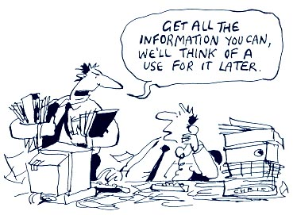
Problem
Notes:
I’m probably preaching to the choir, but if we don’t identify what the issue is, it makes it hard to propose a solution.
We work in an era of increasing accountability and transparency in higher education - administrators, staff/faculty, and students want a dynamic way to access data in a visually appealing interface with minimal hassle like authorization paperwork or logins. Sometimes we can easily meet their wants and needs and sometimes we can’t.

Slide 3
Goals
Notes:
Today Dmitri and I are going to talk about two strategies for disbursing data. One using public facing dashboards and one using private dashboards. The presentation will focus on best practice for implementation strategy and methods for getting started in both realms. This presentation is designed for novice to competent Tableau users and may be repetitive information for proficient and expert Tableau users.

Slide 4
Overview
Public Dashboard Best Practice
Tableau Public
Private Dashboard Best Practice
Tableau Server
Questions and Hopefully the Correct Answers
Notes:
I’m going start with some Best Practice on Dashboard Design, specifically using Tableau Desktop to Design the Dashboards and using Tableau Public to post them to the web. From there, Dmitri is going to demonstrate some best practice for private dashboards and show you how he uses Tableau Desktop and Tableau Server.

Slide 5
Public Dashboard Best Practice
Notes:
What I mean by public dashboards is that these dashboards are available on the web for anyone to use.

Slide 6
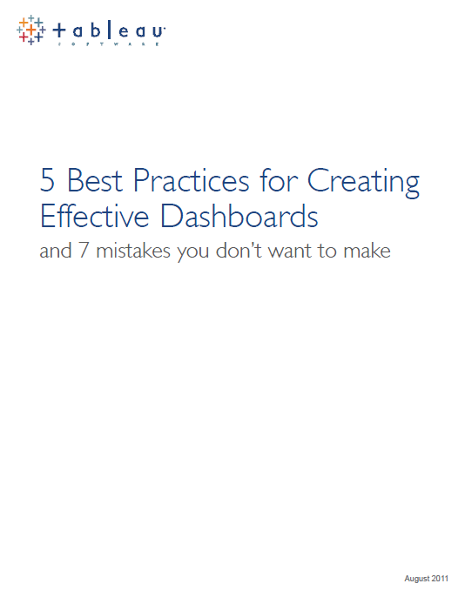
Public Dashboard Best Practice
Steps for creating Dashboards
Choose metrics that matter
Keep it visual
Make it interactive
Keep it current or don’t bother
Make it simple to access and use
Notes:
Choosing which metrics to include in the dashboard is critical. Above all, they must be metrics that matter and that are relevant to the job at hand. But that doesn’t mean every metric should be included – far from it. You should be highly selective in determining which metrics earn a spot on your dashboard by considering your audience.
Keep it visual - numbers requires the brain to store and remember multiple chunks while visualizations or pictures require single chunks. So the process of comprehension and insight is dramatically faster with visualization.
Your dashboard will put everyone who sees it on the same page. But once on the same page, viewers each will have their own questions and areas where they want to know more. Your dashboard needs to allow viewers to customize it so that they get the information they need.
Decide how often you should update your data and clearly communicate that information to your audience so they know when to expect an update.
Make it simple to access and use. Each dashboard should have an ideal audience and a purpose. Make sure your intended audience can access the dashboard easily and once they can understand the goal of the dashboard quickly.

Slide 7
Dashboard Best Practice
Institutional Dashboards: Navigational Tool for Colleges and Universities
Number 123, Winter 2012
Notes:
In winter of 2012, AIR published an interesting article about Dashboards that had some great information.

Slide 8
Dashboard Best Practice
Indicator Group Usage Ranking by Category
Category | Indicator Group | Percent
Financial Indicators | Endowment & Expenses Data | 80%
Admissions | Admissions Scores | 79%
Enrollment | Enrollment Figures | 77%
Faculty | Faculty – General | 77%
Student Outcomes | Graduation Rates | 73%
Notes:
Here are the top 5 categories of data that IR offices have made dashboards for. Last year I had only made dashboards for enrollment and student outcomes data. Now I haven ventured into course outcomes and finance data.

Slide 9
Using Tableau Public
Notes:
Everything I’m going to show you in Tableau Public, was first designed in Tableau Desktop.

Slide 10
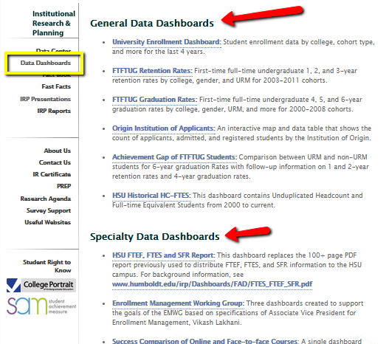
Using Tableau Public
HSU IR Webpage
Meaningful Navigation
General Data Dashboards
Specialty Data Dashboards
Data Dashboards - Under development
Notes:
I’ve decided to list each dashboard in one section rather than scatter them throughout our website. I’ve included 3 general headings to help users find what they’re looking for. It is actually a horrible approach, but it’s not the worst and there id a benefit.

Slide 11
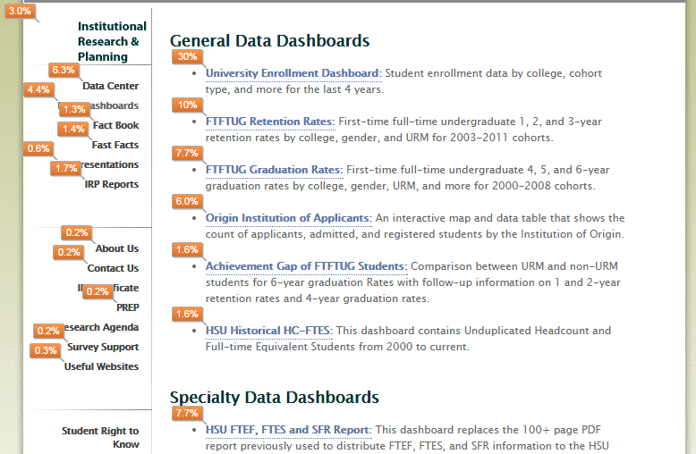
Using Tableau Public
HSU IR Webpage
Meaningful Navigation
Monitor Usage
Engage Specific Audiences
Notes:
I list the dashboards this was because I have connected our website to Google Analytics and use in page diagnostics to explore popularity of my dahboards. Here I can see that about 30% of my traffic go to the University Enrollment Dashboard.

Slide 12
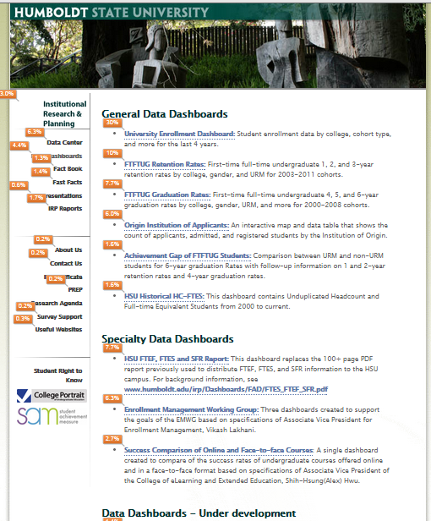
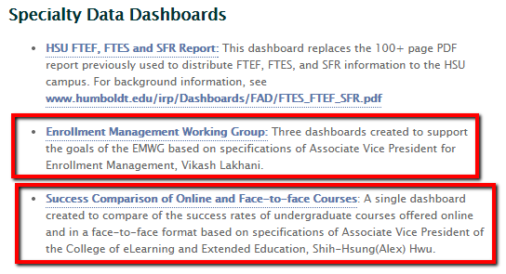
Using Tableau Public
Notes:
Another trick I did to get people hooked on my dashboards was to blatantly name drop. Here are two dashboards created just for two different Associate Vice Presidents. I will demo both next.

Slide 13
Example Time!

Slide 14
Redesigning a PDF

Slide 15
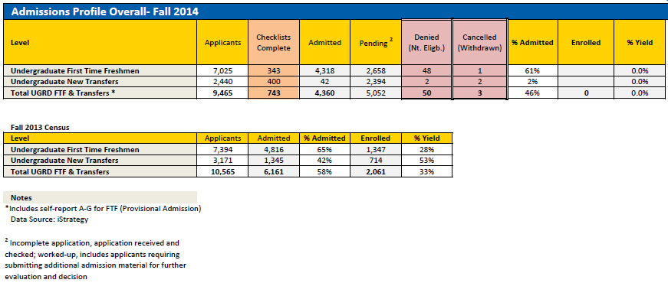
Redesigning a PDF

Slide 16
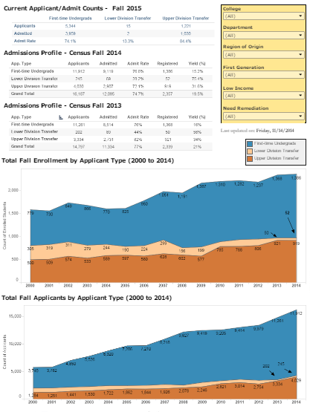
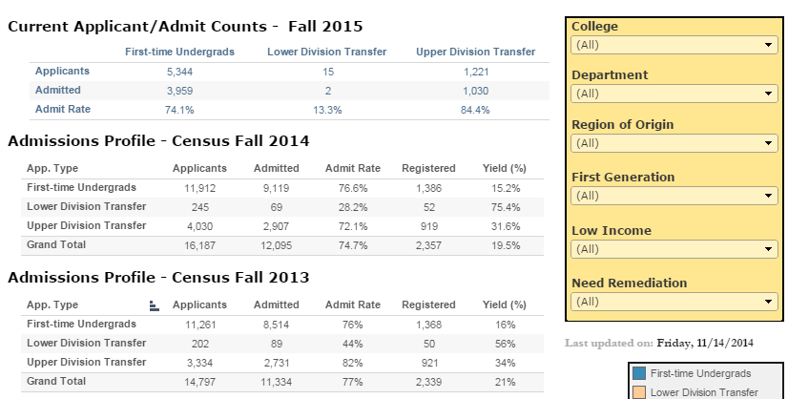
Redesigning a PDF

Slide 17
Answering a question for a Dean

Slide 18
A Question
How do students in online classes do compared to face-to-face classes?

Slide 19
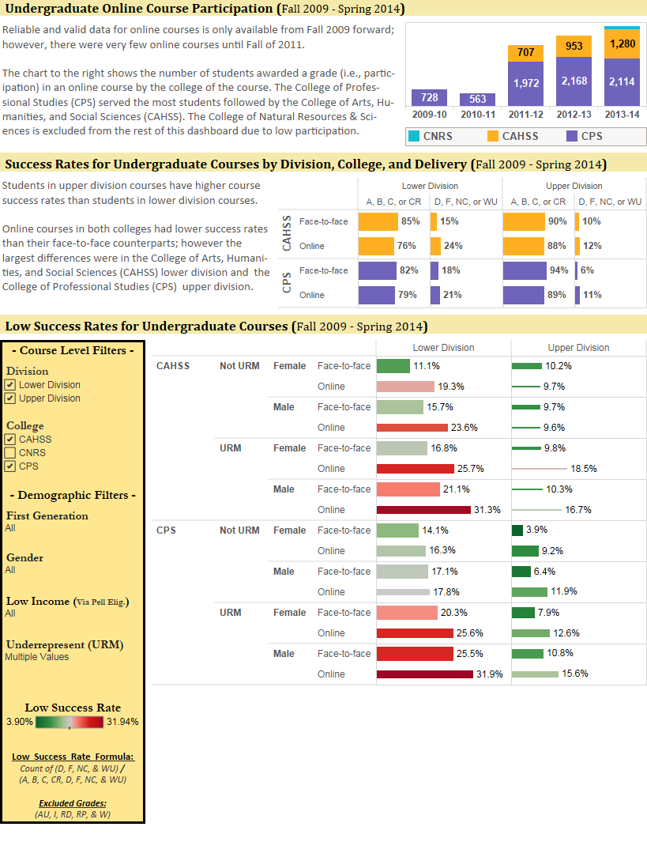
A Question

Slide 20
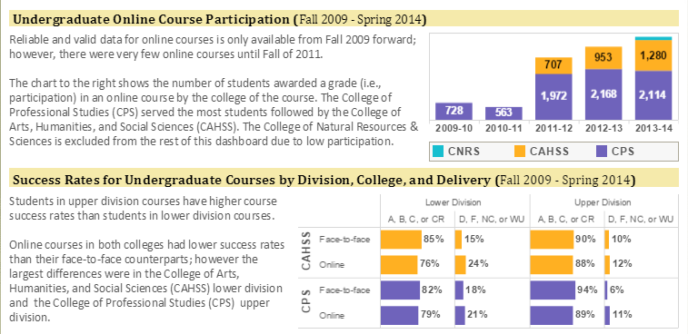
A Question

Slide 21
A Question

Slide 22
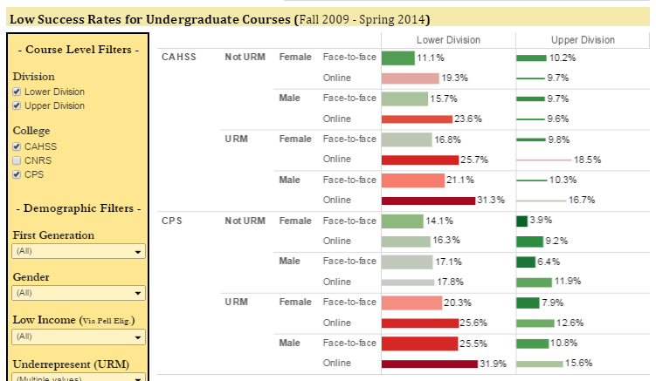
A Question

Slide 23
Humoring a Curiosity for the Budget Office

Slide 24
A Curiosity for Improvement
Mike, I have a data set and I’m wondering if you can Tableau’ify it?

Slide 25
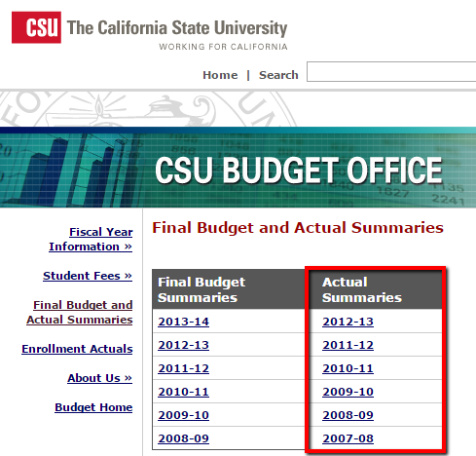
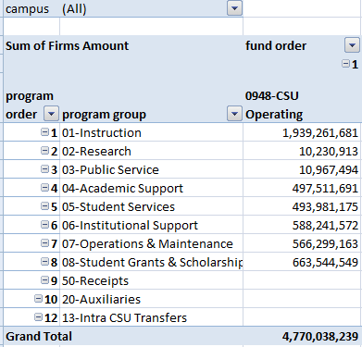
A Curiosity for Improvement

Slide 26
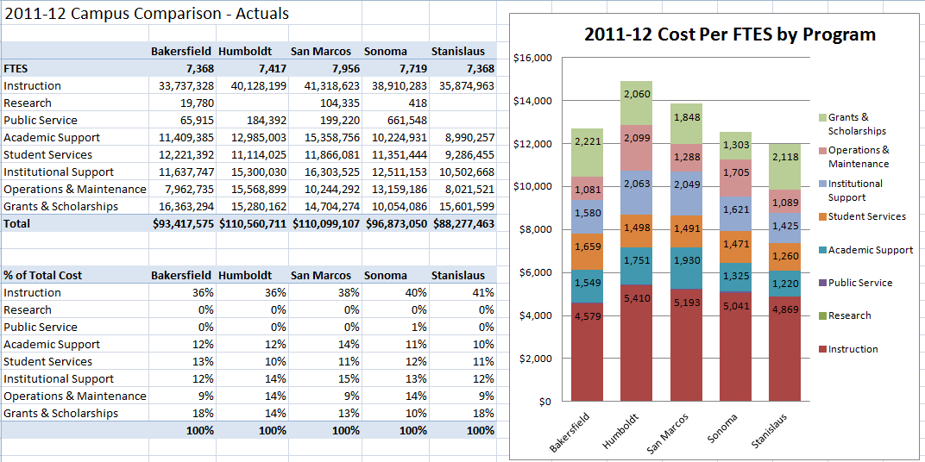
A Curiosity for Improvement

Slide 27
To the WEB! http://www.humboldt.edu/irp/Dashboards/Budget-Actuals-FTES.html

Slide 28
Private Dashboard Best Practice

Slide 29
Private Dashboard Best Practice
Steps for creating Dashboards
Know your audience
Make it simple
Make it actionable

Slide 30
Question and Answer
Michael Le
Humboldt State University
Michael.Le@humboldt.edu
Dmitri Rogulkin
Fresno State University
drogulkin@csufresno.edu
Presentation Will be Posted at:
www.humboldt.edu/irp/presentations.html

